Slide 1
Introduction
John m. Hochwalt, pe, se
Kpff consulting engineers, seattle

Slide 2
The Masonry Society
is an educational, scientific, and technical society dedicated to the advancement of scientific, engineering, architectural, and construction knowledge of masonry.
My Roles:
Chair of the Seismic and Limit Design Subcommittee for TMS 402/602
Voting member of the TMS 402/602
Board of Director's Representative for Zone 1

Slide 3
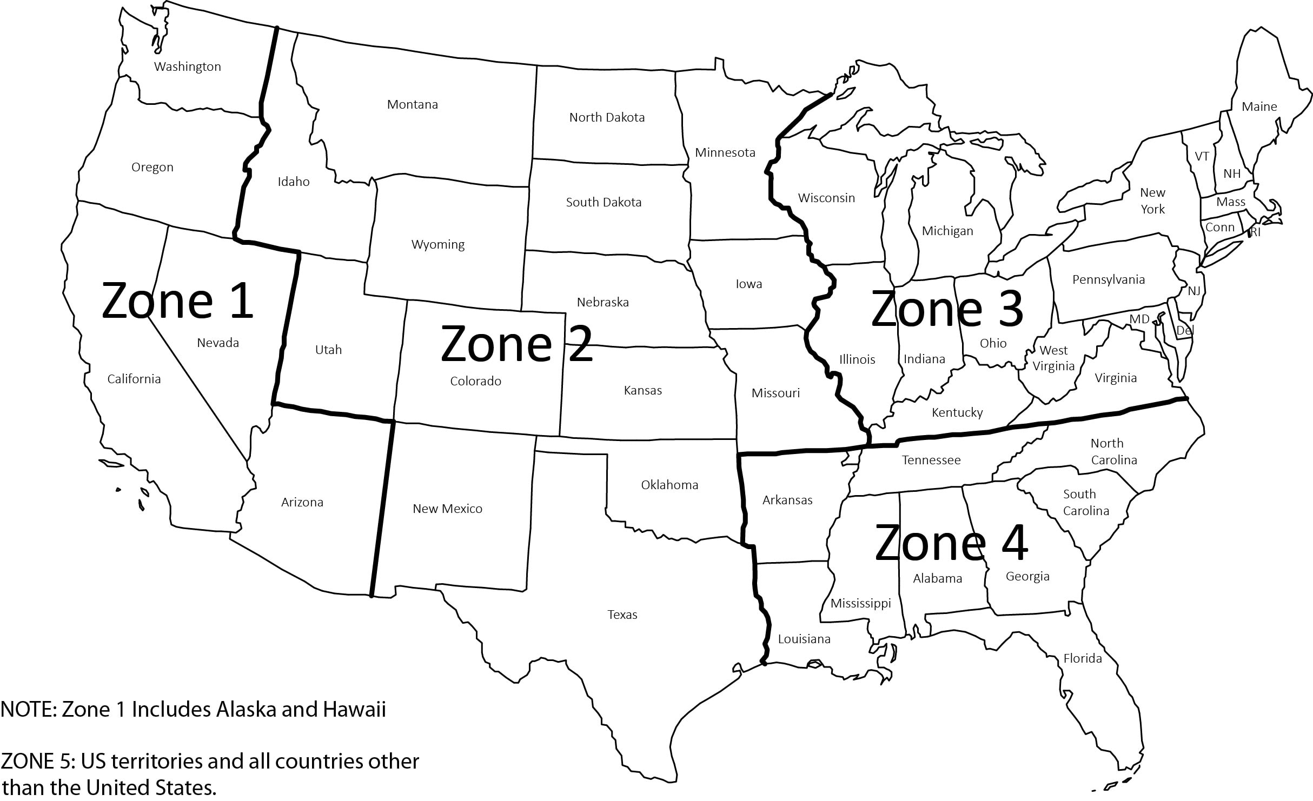
The Masonry Society

Slide 4
The Masonry Society
My Goals for Today:
Give an informative and interesting presentation
Learn from all of you
What challenges do you face in designing masonry in Hawaii?
Are there ways in which existing codes and standards miss the mark in your practices?
How could TMS better provide information to meet your needs.

Slide 5
Masonry Veneers
Anchored and adhered

Slide 6
Outline
Introduction to Veneer
Anchored Veneers
Adhered Veneers

Slide 7
Introduction to Veneer

Slide 8
Introduction to Veneer
What is a veneer?
What types of veneer are there?
Components of veneers
Anchored veneer
Adhered veneer

Slide 9
What is a veneer?
2018 IBC:
Veneer: A facing attached to a wall for the purpose of providing ornamentation, protection, or insulation, but not counted as adding strength to the wall.
TMS 402-16:
Veneer, masonry: A masonry wythe that provides the exterior finish of a wall system and transfers out-of-plane load directly to a backing, but is not considered to add strength or stiffness to the wall system.
Introduction to Veneer
4/12/2022
9

Slide 10
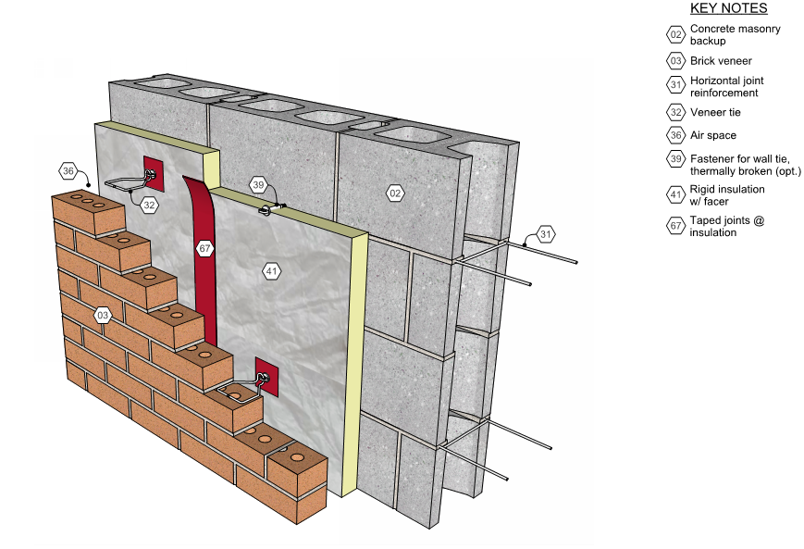
Anchored Veneer
2018 IBC
Veneer secured with approved mechanical fasteners to an approved backing.
Image from imiweb.org

Slide 11
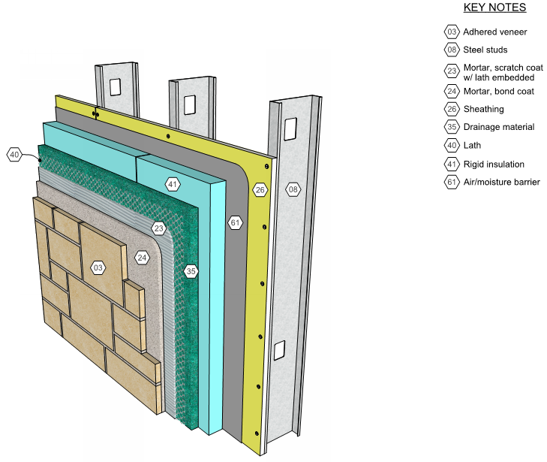
Adhered Veneer
IBC
Veneer secured and supported through the adhesion of an approved bonding material applied to an approved backing.
Image from imiweb.org

Slide 12
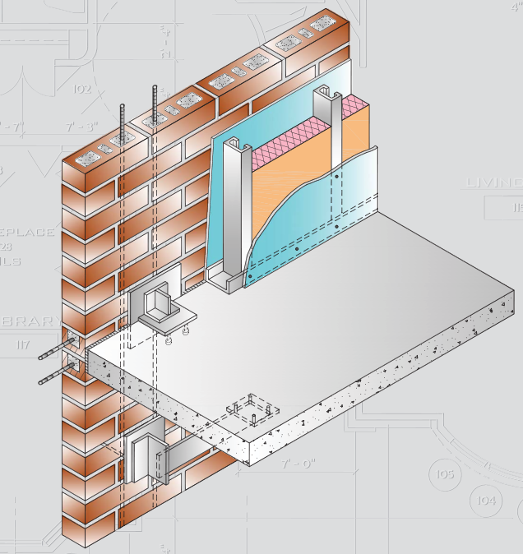
Structural Masonry Veneer
Reinforced masonry wall, typically designed to deliver wind and seismic loads directly to structure. Backing provides support for sheathing, air barrier and insulation, but not masonry.
Allows panelization
Limited connections
High performance
Image from wscpa.org

Slide 13
Anchored Veneer

Slide 14
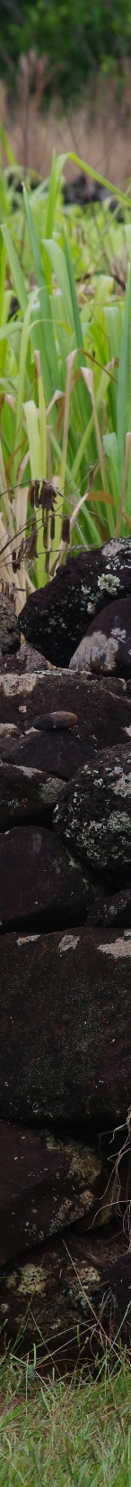
Agenda
Behavior of Anchored Veneers
Code Requirements
Prescriptive Design
Alternative Design
Full Engineered Method
Tributary Area Method

Slide 15
What do we want to know?
How does the anchored veneer behave as a system?
What criteria should we use to assess veneer behavior?
Behavior of Anchored Veneer
4/12/2022
15

Slide 16
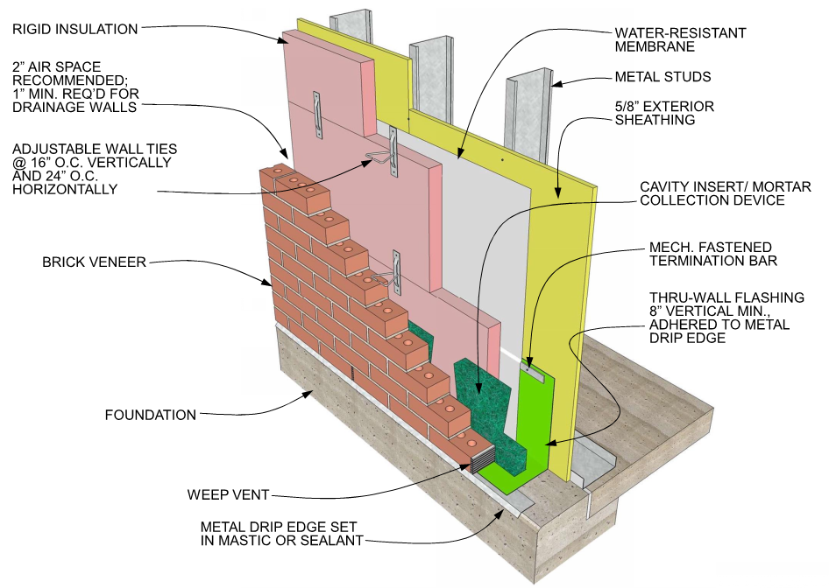
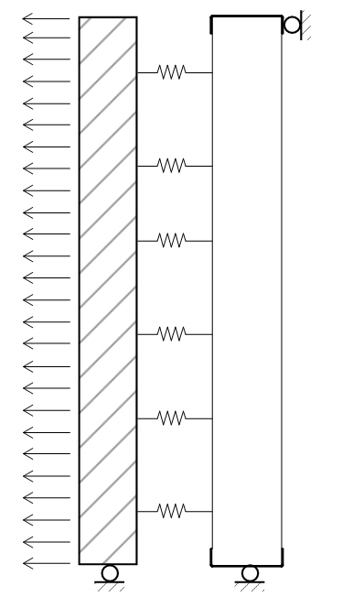
Behavior of Anchored Veneers
Image from imiweb.org
Behavior of Anchored Veneer
4/12/2022
16

Slide 17
Behavior of Components
Behavior of Components
Masonry
High stiffness, low strength
Will Crack
Anchors and Backing
Elastic
Backing
Anchors
Masonry
Behavior of Anchored Veneer
4/12/2022
17

Slide 18
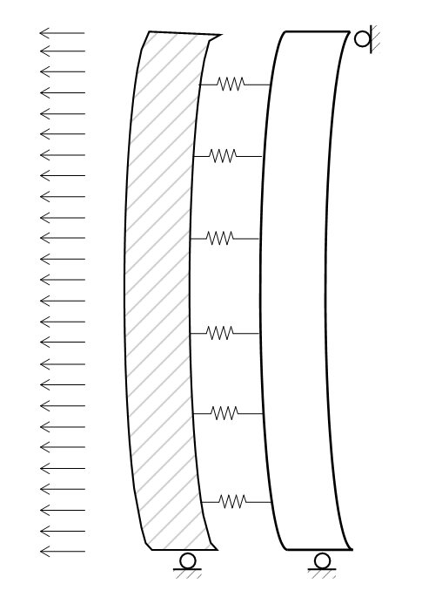
Initial Behavior
Load
Biggest pressure differential across veneer
Masonry
Masonry stiffest element
Load stays in veneer
Anchors
Load transferred at top and bottom anchors
Behavior of Anchored Veneer
4/12/2022
18

Slide 19
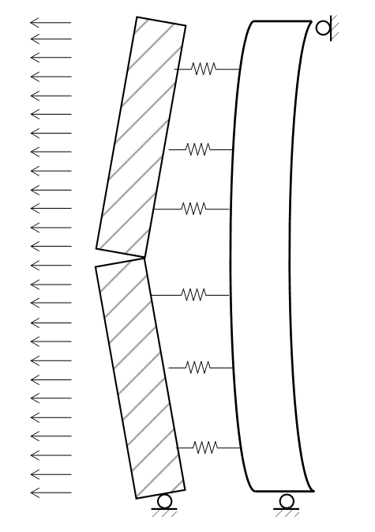
Behavior at Service Loads
Masonry
Masonry cracks
Anchors
Load transferred at top and bottom anchors and anchors adjacent to cracks
Behavior of Anchored Veneer
4/12/2022
19

Slide 20
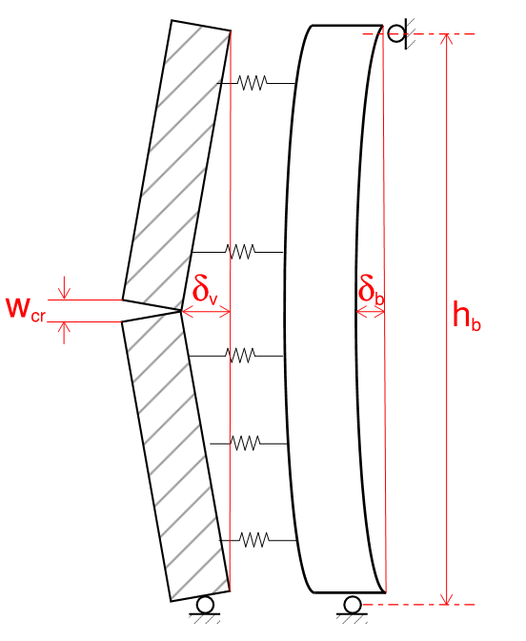

Service Load Criteria
Limit Ingress of Water
Limit Crack Width
$$w_{cr}=t_{sp}θ_{cr}$$
$θ_{cr}$=2$\frac{δ_{v}}{{h_{b}}/2}$
$$w_{cr}=\frac{4δ_{v}t_{sp}}{h_{b}}$$
$$δ_{v}=\frac{w_{cr}h_{b}}{4t_{sp}}=\frac{h_{b}}{{4t_{sp}}/{w_{cr}}}$$
Behavior of Anchored Veneer
4/12/2022
20

Slide 21

Service Load Criteria
Suggested maximum crack width:
0.04” (WSCPA)
0.05” (Clark and Fried)
Suggested veneer deflection limit:
$$δ_{v}=\frac{h_{b}}{{4t_{sp}}/{w_{cr}}}=\frac{h_{b}}{{4(3.625")}/{(0.04")}}$$
$$δ_{v}=\frac{h_{b}}{360}$$
Behavior of Anchored Veneer
4/12/2022
21

Slide 22
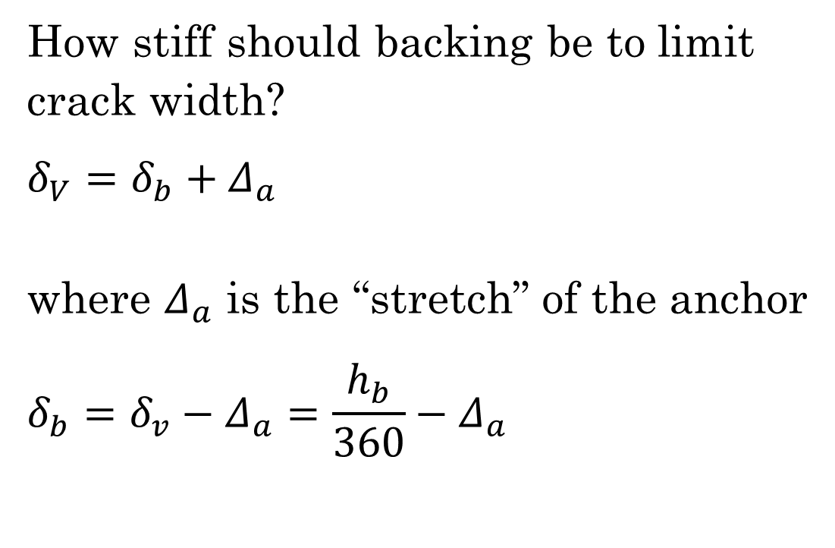
Service Load Criteria
How stiff should backing be to limit crack width?
$$δ_{V}=δ_{b}+Δ_{a}$$
where $Δ_{a}$ is the “stretch” of the anchor
$$δ_{b}=δ_{v}−Δ_{a}=\frac{h_{b}}{360}−Δ_{a}$$
Behavior of Anchored Veneer
4/12/2022
22

Slide 23
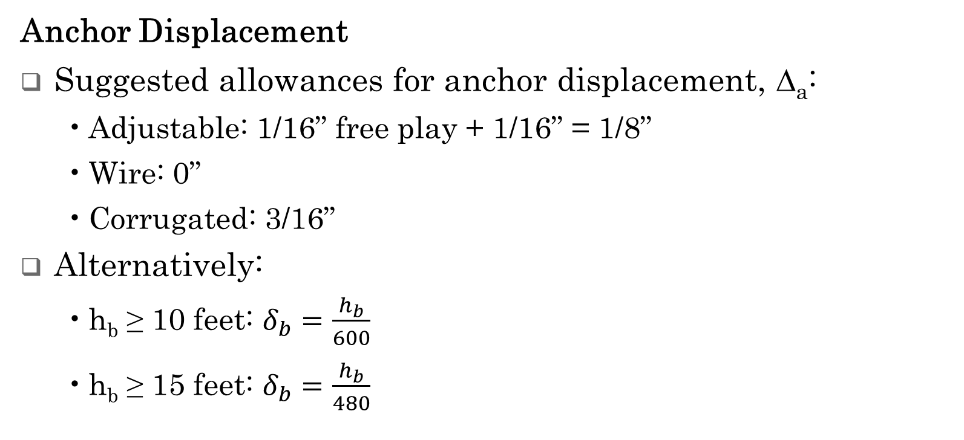
Service Load Criteria
Anchor Displacement
Suggested allowances for anchor displacement, Δ_{a}:
Adjustable: 1/16” free play + 1/16” = 1/8”
Wire: 0”
Corrugated: 3/16”
Alternatively:
h_{b} ≥ 10 feet: $δ_{b}=\frac{h_{b}}{600}$
h_{b} ≥ 15 feet: $δ_{b}=\frac{h_{b}}{480}$
Behavior of Anchored Veneer
4/12/2022
23

Slide 24
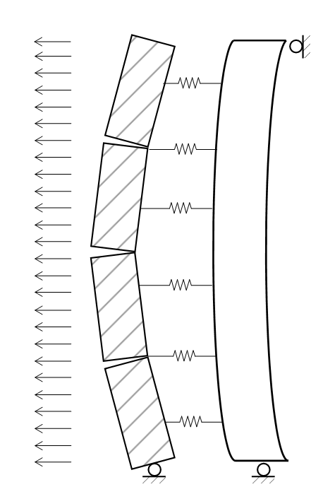
Behavior at Ultimate Loads
Masonry
Multiple masonry cracks may develop
Anchors
Load transferred at top and bottom anchors and anchors adjacent to cracks
Stiffer anchors = higher anchor forces
Behavior of Anchored Veneer
4/12/2022
24

Slide 25
Ultimate Load Criteria
Limit States
Loss of Veneer Stability
Expected to be required in TMS 402-22
Anchor Failure
Will discuss later
Backing Failure
Design for code compliance
Behavior of Anchored Veneer
4/12/2022
25

Slide 26
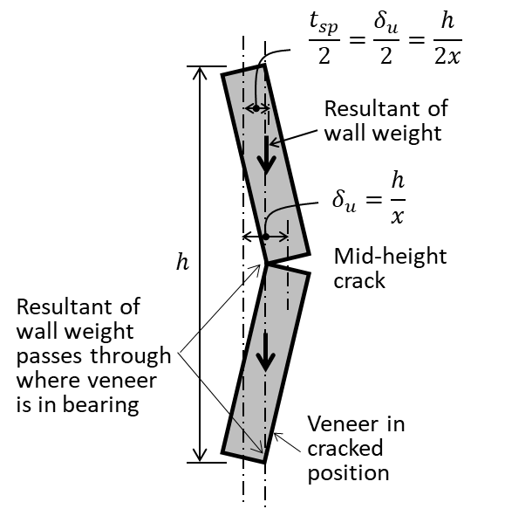
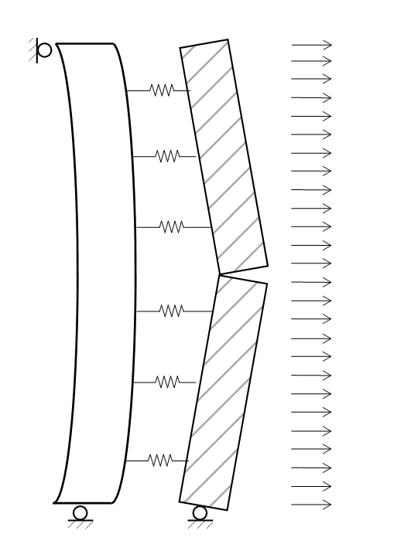
Ultimate Load Criteria - Stability
Behavior of Anchored Veneer
4/12/2022
26

Slide 27


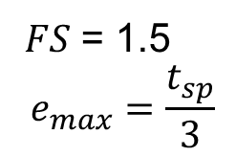
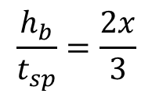
Ultimate Load Criteria - Stability
Behavior of Anchored Veneer
4/12/2022
27

Slide 28
Ultimate Load Criteria - Stability
Ultimate Deflection (wind or seismic) | Service Level Deflection (0.42 wind) | Maximum Value for FS = 1.5
 |  | h_{b}/t_{sp} | h_{b} for t_{sp} = 2-5/8 inch | h_{b} for t_{sp} = 3.5 inch
h_{b}/100 | h_{b}/240 | 67 | 14.6 ft | 19.5 ft
h_{b}/150 | h_{b}/360 | 100 | 21.9 ft | 29.2 ft
h_{b}/200 | h_{b}/480 | 133 | 29.1 ft | 38.8 ft
h_{b}/250 | h_{b}/600 | 167 | 36.5 ft | 48.7 ft
Behavior of Anchored Veneer
4/12/2022
28

Slide 29
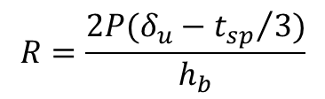
Ultimate Load Criteria - Stability
Anchors can provide a restoring force to maintain veneer stability.
R
Behavior of Anchored Veneer
4/12/2022
29

Slide 30
Agenda
Behavior of Anchored Veneers
Code Requirements
Prescriptive Design
Alternative Design
Full Engineered Method
Tributary Area Method

Slide 31

2018 International Building Code
1402.3 Structural
Designed and constructed to resist Chapter 16 loads
1403.4 Masonry
“Masonry units, mortar, and metal accessories used in anchored and adhered veneer shall meet the physical requirements of Chapter 21.”
Code Requirements for Anchored Veneer
4/12/2022
31

Slide 32
2018 International Building Code
1404.2 Weather protection
Table 1404.2 Minimum thickness of weather coverings:
Natural Stone: 2 in.
Architectural cast stone: 1 ¼ in.
Other: 2 in.
1404.4.2 addresses flashing and weep holes
Code Requirements for Anchored Veneer
4/12/2022
32

Slide 33
2018 International Building Code
1404.6 References TMS 402 for anchored veneer design.
Code Requirements for Anchored Veneer
4/12/2022
33

Slide 34
2018 International Building Code
Chapter 16
Table 1604.3 Deflection limits
1609.1.1 References ASCE 7 for wind loads
1613.1 References ASCE 7 for seismic loads
Code Requirements for Anchored Veneer
4/12/2022
34

Slide 35
2018 International Building Code
Table 1604.3
Deflection Limits
Construction | L or Lr | S or W^{f} | D + L
Exterior Walls:
With Plaster or stucco finishes | - | l/360 | -
With other brittle finishes | - | l/240 | -
With flexible finishes | - | l/120 | -
^{f}The wind load shall be permitted to be taken as 0.42 times the “component and cladding” load or directly calculated using the 10-year mean return interval wind speed for the purpose of determining deflection limits in Table 1604.3. Where framing members support glass, the deflection limit therein shall not exceed that specified in Section 1604.3.7.
Code Requirements for Anchored Veneer
4/12/2022
35

Slide 36
A Digression
A digression on wind loads and deflection limits
Code or Standard | Deflection Limit | Recurrence Interval
IBC 2018 | l/240 | 10 years
BIA Technical Note 28B | l/600 | 50 years
AISI CF03-1 | l/600 | 10 years
WSCPA Brick Veneer on Steel Studs Guide | l/360 – 1/8" | 10 years
Code Requirements for Anchored Veneer
4/12/2022
36

Slide 37
2018 International Building Code
Chapter 21 Masonry
2101 General
2101.2.1 directs user back to Chapter 14 for design of veneers.
Code Requirements for Anchored Veneer
4/12/2022
37

Slide 38
2018 International Building Code
2103 Materials
2103.1 Masonry units
Concrete, clay, and stone per TMS 602 Article 2.3
Architectural cast stone per ASTM C1364 and TMS 504
2103.2 Mortar
TMS 602 Articles 2.1 and 2.6 A.
2103.4 Metal reinforcement and accessories
Code Requirements for Anchored Veneer
4/12/2022
38

Slide 39
2018 International Building Code
2103 Materials
2103.2 Mortar
TMS 602 Articles 2.1 and 2.6 A.
2103.4 Metal reinforcement and accessories
TMS 602 Article 2.4.
Code Requirements for Anchored Veneer
4/12/2022
39

Slide 40

ASCE 7-16 – Minimum Design Loads
Chapter 13: Seismic Design Requirements for Nonstructural Components
Chapter 30: Wind Loads – Components and Cladding
Code Requirements for Anchored Veneer
4/12/2022
40

Slide 41
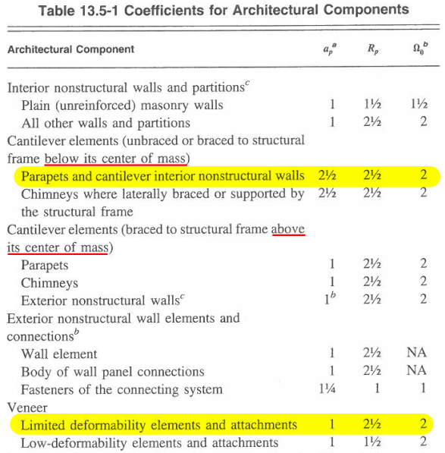
ASCE 7-16 – Minimum Design Loads
Seismic Loads:
Code Requirements for Anchored Veneer
4/12/2022
41

Slide 42
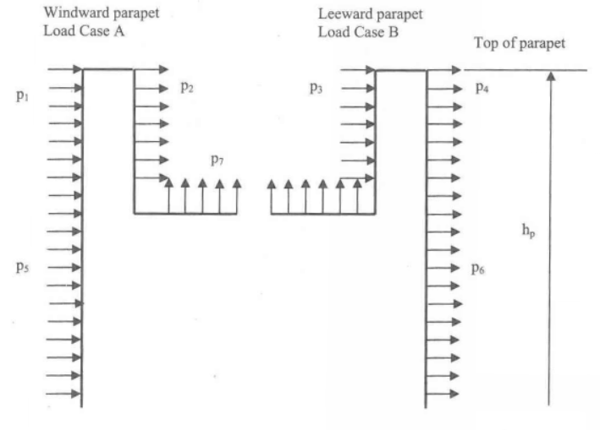

ASCE 7-16 – Minimum Design Loads
Special Notes on Wind Loads
Tributary area – Use ${h_{b}^{2}}/3$ (ASCE 7 C26.2)
Parapets – Use ASCE 7 Figure 30.8-1
Code Requirements for Anchored Veneer
4/12/2022
42

Slide 43
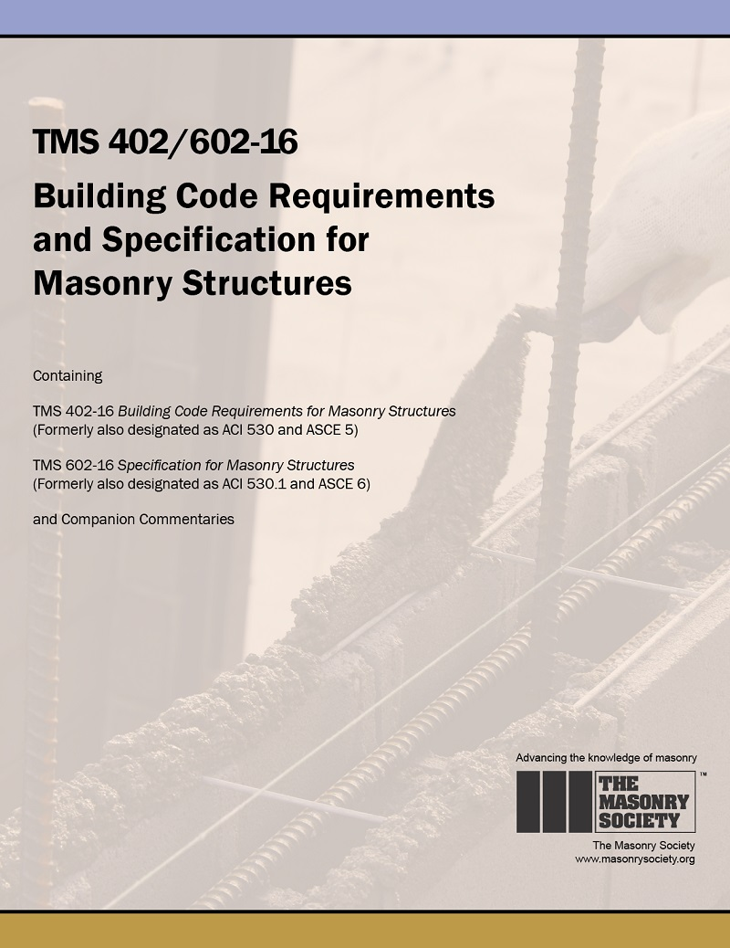
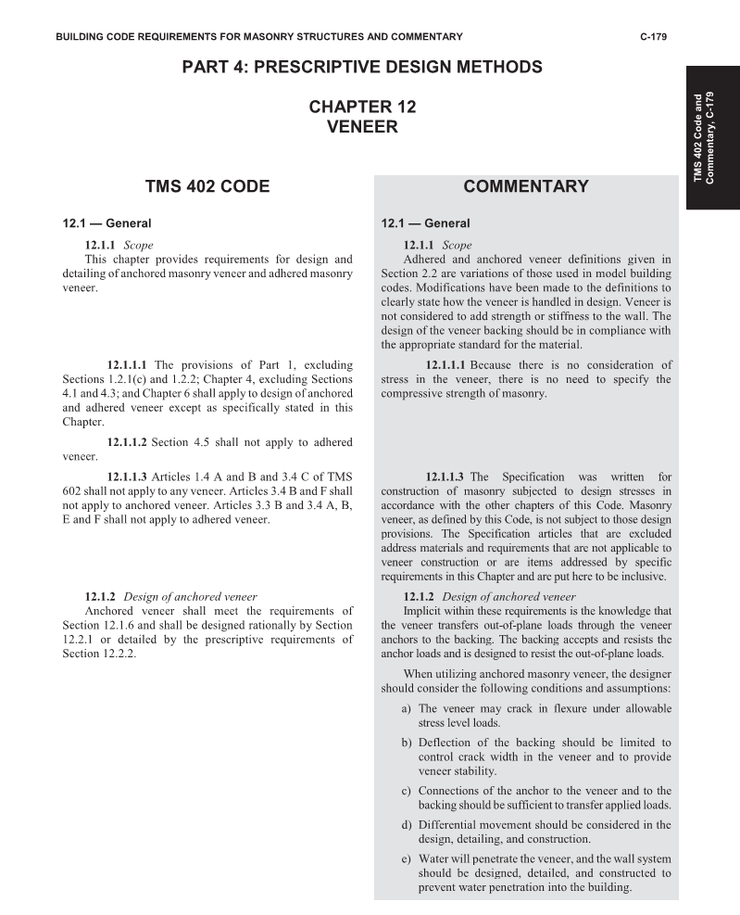
TMS 402/602 - 16
Code Requirements for Anchored Veneer
4/12/2022
43

Slide 44
TMS 402-16
Organization of Chapter 12
12.1 General
12.2 Anchored Veneer
12.2.1 Alternate (Rational) Design
12.2.2 Prescriptive
12.3 Adhered Veneer
Code Requirements for Anchored Veneer
4/12/2022
44

Slide 45
TMS 402-16
12.1 General
Not required to define or test f’_{m}
Reinforcement required for masonry not laid in running bond
Area = 0.00028 x gross vertical area
Max spacing = 48 in.
Code Requirements for Anchored Veneer
4/12/2022
45

Slide 46
TMS 402-16
12.1 General
Not required to define or test f’_{m}
12.1.4 excludes anchored dimension stone from provisions (expected to be included in TMS 402-22)
12.1.6
Addresses control of water
Design and detail veneer to accommodate differential movement.
Code Requirements for Anchored Veneer
4/12/2022
46

Slide 47
TMS 602-16
Article 2.1 Mortar
ASTM C270
Article 2.3 Masonry units
Concrete, clay and stone units – numerous ASTM’s
Reminder:
Cast stone per IBC (no conflict)
Stone outside of Chapter 12
Code Requirements for Anchored Veneer
4/12/2022
47

Slide 48
TMS 602-16
Article 2.4 Reinforcement, prestressing tendons, and metal accessories
Reinforcement for veneer not laid in running bond.
Single wire
Same cold-worked wire as joint reinforcement
Knurled like joint reinforcement longitudinal wires
Includes requirements for anchors
Code Requirements for Anchored Veneer
4/12/2022
48

Slide 49
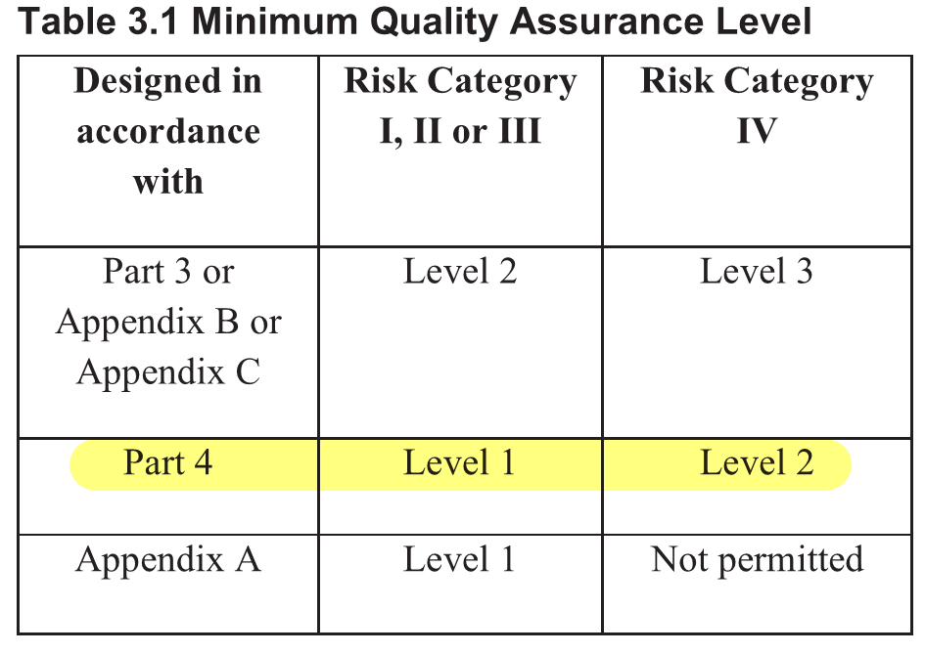
Quality Assurance
TMS 402
TMS 602
Table 3 – Verification
Prior to construction, verification of compliance of submittals.
Table 4 – Special Inspection
Only required in Risk Category IV
Design professional can choose to exceed these minimums
Code Requirements for Anchored Veneer
4/12/2022
49

Slide 50
Agenda
Behavior of Anchored Veneers
Code Requirements
Prescriptive Design
Alternative Design
Full Engineered Method
Tributary Area Method

Slide 51
Prescriptive Design
General Requirements
Most anchored veneers are constructed using this method
Based on historical practice, not engineering.
Provides maximum anchor spacing, based on:
Wind pressure, q_{h}
Seismic Design Category
Anchor Type
Prescriptive Design of Anchored Veneers
4/12/2022
51

Slide 52
Prescriptive Design - Limitations
Limitations Loads
Wind loads
Velocity pressure, q_{z} ≤ 55 psf (12.2.2.1, 12.2.2.12)
If q_{z} > 40 psf, Mean roof height, h ≤ 60 feet (12.2.2.12)
Seismic Loads – No limit
Prescriptive Design of Anchored Veneers
4/12/2022
52

Slide 53
Prescriptive Design - Limitations
Limitations - Geometric
Cavity 6 5/8” maximum
Note special requirements when cavity > 4 5/8”
Air Space 1” minimum
Unit Thickness
Unit thickness ≥ 2 5/8” (12.2.2.3.1)
Note: Controls over IBC minimum thickness for weather protection
Image from imiweb.org
Prescriptive Design of Anchored Veneers
4/12/2022
53

Slide 54
Prescriptive Design - Supports
Supported on non-combustible construction (12.2.2.3.1). Exceptions:
Exterior ≤ 12’ of veneer weighing ≤ 40 psf. (12.2.2.3.1.2)
Interior ≤ 40 psf (12.2.2.3.1.3)
Construction supporting supports must also be non-combustible. (12.2.2.3.2)
Deflections of supports under dead + live ≤ l/600. (12.2.2.3.3)
Prescriptive Design of Anchored Veneers
4/12/2022
54

Slide 55
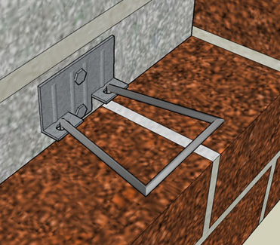
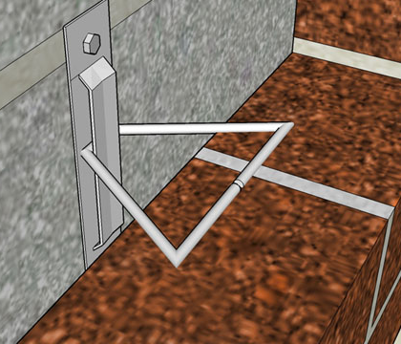
Prescriptive Design - Anchors
Adjustable Anchors (12.2.2.5.5)
Adjustable by 1 ¼”
Max 1/16” clearance
Construction prescribed
Used with all backing types
One anchor for 2.67 ft²
Wind > 40 psf: 1.87 ft²
Seismic D+: 2.00 ft²
Adjustable
Adjustable
Prescriptive Design of Anchored Veneers
4/12/2022
55

Slide 56
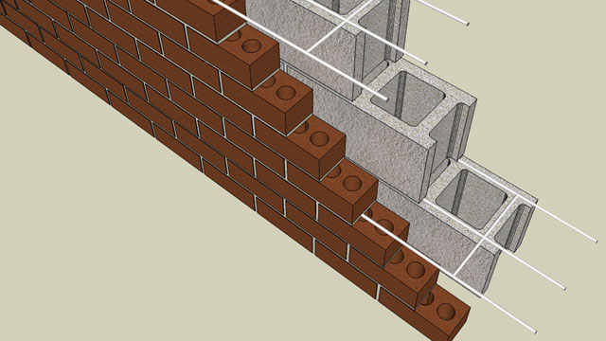
Prescriptive Design - Anchors
Wire and Joint Reinforcement Anchors
Prescriptive wire size
Used with masonry backing
One anchor for 3.50 ft²
Wind > 40 psf: 2.45 ft²
Seismic D+: 2.62 ft²
Joint Reinforcing
Prescriptive Design of Anchored Veneers
4/12/2022
56

Slide 57
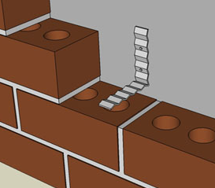
Prescriptive Design - Anchors
Corrugated Anchors
Wood backing only
1” max space to sheathing
Consider ring shanked nail in lieu of common nail allowed by TMS 402.
Corrugated
Prescriptive Design of Anchored Veneers
4/12/2022
57

Slide 58
Prescriptive Design - Anchors
Anchor Spacing (12.2.2.5.6)
Adjustable two-piece anchors, anchors of wire size W1.7 provide at least one anchor for each 2.67 ft2 of wall area.
Spacing not to exceed 32” horizontally and 25” vertically
Additional anchors around openings.
Prescriptive Design of Anchored Veneers
4/12/2022
58

Slide 59
Prescriptive Design - Anchors
Anchor Spacing
Seismic Design Category D+ (12.2.2.11.2.2)
Reduce area supported by ties to 75%
High Wind: q_{z} > 40 psf (12.2.2.3.1)
Reduce area supported by ties to 70%
18” max tie spacing
Tighter tie spacing around openings
Prescriptive Design of Anchored Veneers
4/12/2022
59

Slide 60
Prescriptive Design - Backing
Clay, concrete, or cast stone units
Anchors and Fastening of anchors to backing
See 12.2.2.5
Steel studs must be corrosion resistant and have minimum thickness of 0.043 in. (12.2.2.7.4)
Prescriptive Design of Anchored Veneers
4/12/2022
60

Slide 61
Prescriptive Design - Backing
Backing types addressed:
Wood (12.2.2.6)
Steel (12.2.2.7)
Concrete (12.2.2.8)
Masonry (12.2.2.9)
Prescriptive Design of Anchored Veneers
4/12/2022
61

Slide 62
Prescriptive Design – Wood Backing
Wood backing – height of veneer cannot exceed 30’ (38’ at gable) above support (12.2.2.6.1)
Requirements for fastening anchor to wood (12.2.2.6.3)
Prescriptive Design of Anchored Veneers
4/12/2022
62

Slide 63
Prescriptive Design – Steel Backing
Steel studs must be corrosion resistant and have minimum thickness of 0.043 in. (12.2.2.7.4)
Steel backing if height of anchored veneer exceeds 30’ (38’ at gable) above support, must support at each floor above 30’. (12.2.2.7.1)
Requirements for fastening anchor to steel (12.2.2.7.3)
Prescriptive Design of Anchored Veneers
4/12/2022
63

Slide 64
Not Laid In Running Bond
Not Laid in Running Bond requires at least one W1.7 wire, at 18” oc vertically. (12.2.2.10)
Must also comply with Section 4.5 – will control when veneer thickness exceeds 3-3/8 in.
Prescriptive Design of Anchored Veneers
4/12/2022
64

Slide 65
Agenda
Behavior of Anchored Veneers
Code Requirements
Prescriptive Design
Alternative Design
Full Engineered Method
Tributary Area Method

Slide 66
Code Requirements
Alternate Design Requirements
12.2.1 Alternative design . . . shall satisfy the following conditions:
(a) Loads shall be distributed through the veneer to the anchors and the backing using principles of mechanics.
(b) Out-of-plane deflection of the backing shall be limited to maintain veneer stability.
Alternative Design of Anchored Veneer
4/12/2022
66

Slide 67
Code Requirements
Alternate Design Requirements
(c) The veneer is not subject to the flexural tensile stress provisions of Section 8.2 or the nominal flexural tensile strength provisions of Section 9.1.9.2.
(d) The provisions of Section 12.1, Section 12.2.2.10, and Section 12.2.2.11 shall apply.
Code Requirements for Anchored Veneer
4/12/2022
67

Slide 68
Code Requirements
Alternate Design Requirements
12.1.6.3 Design and detail the veneer to accommodate differential movement.
12.2.10 Not in Running Bond – reinforcing of veneer required:
Not Laid in Running Bond requires at least one W1.7 wire, at 18” oc vertically. (12.2.2.10)
Note: SDC based requirement for reinforcing is no longer in TMS 402.
Code Requirements for Anchored Veneer
4/12/2022
68

Slide 69
Code Requirements
Alternate Design Requirements
12.2.11 High Seismic
C+: Isolate sides and top of veneer
D+: Reduce area supported by ties to 75%, fasteners to wood (????)
E+: Support veneer at every floor
Code Requirements for Anchored Veneer
4/12/2022
69

Slide 70
Code Requirements
Alternate Design Commentary
12.1.1 Commentary
. . .the designer should consider the following conditions and assumptions:
The veneer may crack in flexure under allowable stress level loads.
Deflection of the backing should be limited to control crack width in the veneer and to provide veneer stability.
Code Requirements for Anchored Veneer
4/12/2022
70

Slide 71
Code Requirements
Alternate Design Commentary
Connections of the anchor to the veneer and to the backing should be sufficient to transfer applied loads.
Differential movement should be considered in the design, detailing, and construction.
Water will penetrate the veneer, and the wall system should be designed, detailed, and constructed to prevent water penetration into the building.
Code Requirements for Anchored Veneer
4/12/2022
71

Slide 72
Code Requirements
Alternate Design Commentary
Requirements for corrosion protection and fire resistance must be included.
Code Requirements for Anchored Veneer
4/12/2022
72

Slide 73
Agenda
Behavior of Anchored Veneers
Code Requirements
Prescriptive Design
Alternative Design
Full Engineered Method
Tributary Area Method

Slide 74
Full Engineered Method
Suggested Procedure
Determine Loads
Design Backing
Check Stability
Select Anchor Type
Estimate Anchor Spacing
Pseudo-Nonlinear Analysis
Verify Anchor Demands
Alternative Design of Anchored Veneer
4/12/2022
74

Slide 75
Modeling Anchored Veneer
Image from imiweb.org
Full Engineered Design of Anchored Veneer
4/12/2022
75

Slide 76
Modeling - Masonry
Masonry Component Behavior
Cracking Allowed – Model Non-Linear Behavior
Material Properties
Elastic Stiffness
Cracking strength
Full Engineered Design of Anchored Veneer
4/12/2022
76

Slide 77
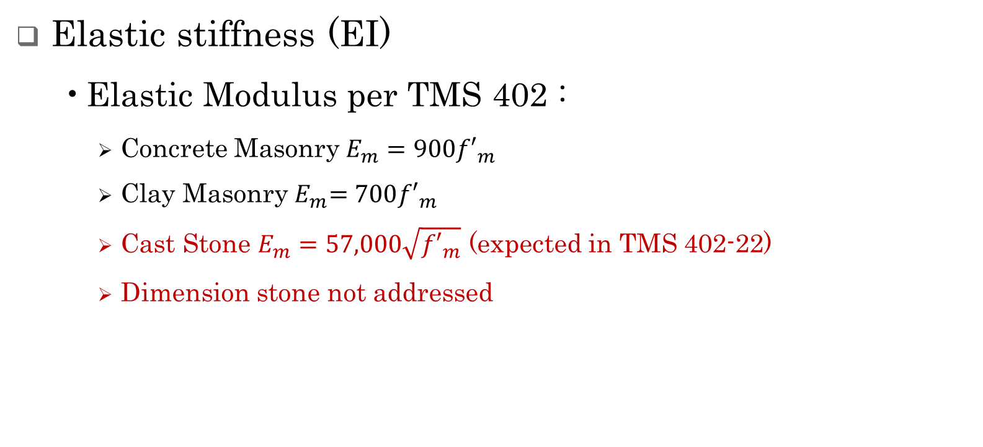
Masonry – Material Properties
Elastic stiffness (EI)
Elastic Modulus per TMS 402 :
Concrete Masonry$E_{m}=900{f′}_{m}$
Clay Masonry${ E}_{m}=700{f′}_{m}$
Cast Stone $E_{m}=57,000\sqrt{{f′}_{m}}$ (expected in TMS 402-22)
Dimension stone not addressed
Full Engineered Design of Anchored Veneer
4/12/2022
77

Slide 78
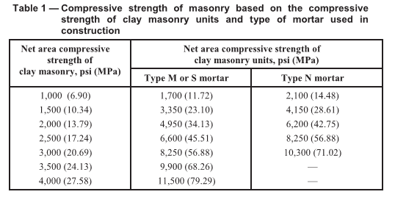
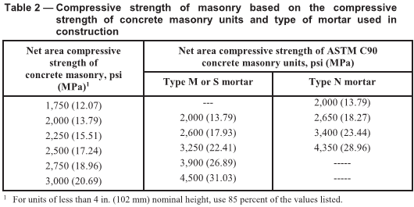
Masonry – Determining f’_{m}
Clay and concrete units, can use unit strength method to determine f’_{m}
Clay
Concrete
For veneers, unit strength may be unknown.
Full Engineered Design of Anchored Veneer
4/12/2022
78

Slide 79
Masonry – Determining f’_{m}
Cast stone
Minimum unit strength = 6,500 psi (ASTM C1364)
Prism test to determine f’_{m}
Dimension stone
Not addressed, presumably prism test
Full Engineered Design of Anchored Veneer
4/12/2022
79

Slide 80
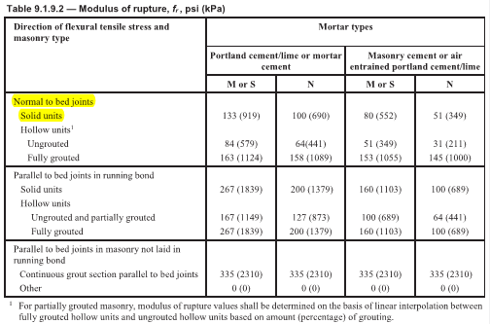
Masonry – Material Properties
Cracking strength (f_{r}S)
Thickness of units (S)
Modulus of Rupture (f_{r})
For veneers, Type N Mortar is typically preferred.
Full Engineered Design of Anchored Veneer
4/12/2022
80

Slide 81
Anchor Properties
Assume linear elastic behavior, need:
Stiffness
Strength
Full Engineered Design of Anchored Veneer
4/12/2022
81

Slide 82
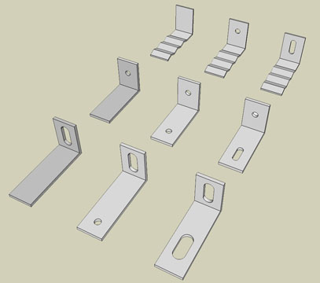
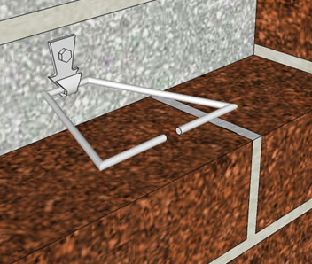
Anchor Properties
Anchor Component Behavior
Images from “Masonry Anchors and Ties by the Code,” Paul Curtis, Masonry.
Full Engineered Design of Anchored Veneer
4/12/2022
82

Slide 83
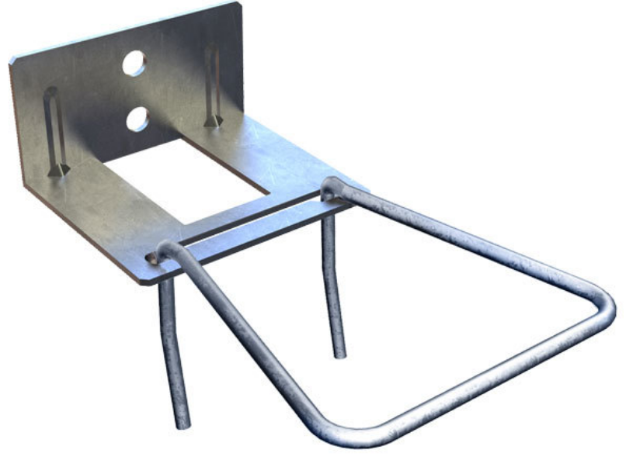
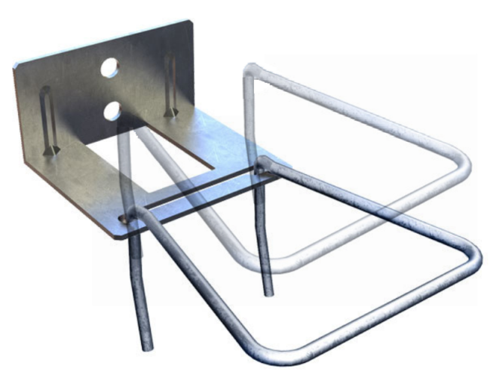
Anchor Properties
Adjustable – 2 Leg
Adjustable by 1 ¼”
Properties vary based on position
1/16” free play
Used with all backing types
Adjustable
Full Engineered Design of Anchored Veneer
4/12/2022
83

Slide 84
Anchor Properties
Limit States for Adjustable 2-Leg Anchors
Pull Out / Push Through at the Mortar Joint
Failure within Anchor
Buckling
Tension yielding
Tension rupture
Flexural yielding
Failure of Fastener to Backing
Adjustable
Full Engineered Design of Anchored Veneer
4/12/2022
84

Slide 85
Anchor Properties
Manufacturers
Research
“Proposed Changes to the TMS 402 Anchored Veneer Provisions”, Hochwalt, Bennett, et al, Proceedings of the 13th North American Masonry Conference, 2019.
Mostly Bennett
Sources of Information on Anchor Behavior
Adjustable
Full Engineered Design of Anchored Veneer
4/12/2022
85

Slide 86
Anchor Properties
No standard for anchor testing in US
Tests often do not consider mortar or fastener failure modes
Are tests compliant with IBC 1709?
Cautions on Manufacturer Data
Adjustable
Full Engineered Design of Anchored Veneer
4/12/2022
86

Slide 87

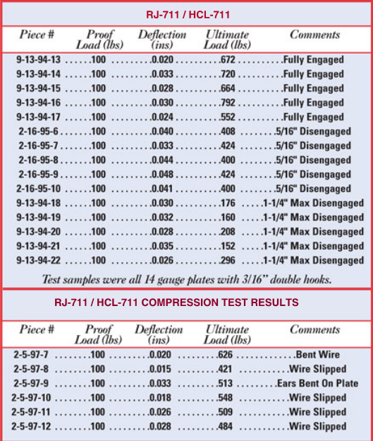
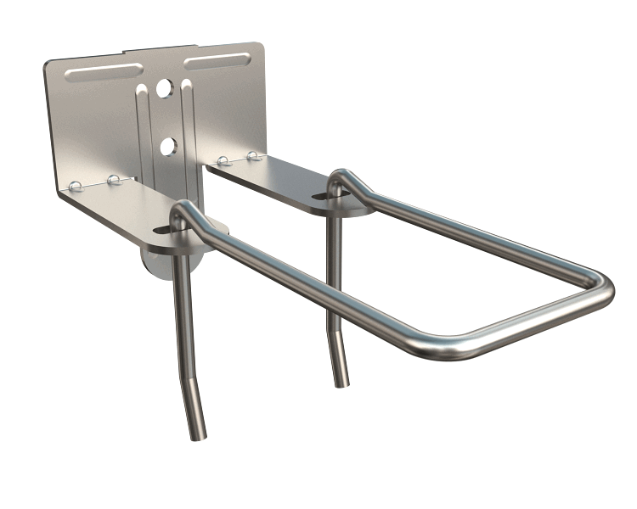
Anchor Properties
Example Manufacturer Data
How wide was cavity?
What position was anchor in for compression testing?
Use the mean test value? Apply some statistical analysis?
What factor of safety should be applied?
Was mortar joint pull out / push through tested?
Full Engineered Design of Anchored Veneer
4/12/2022
87

Slide 88
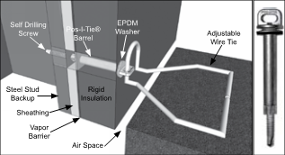

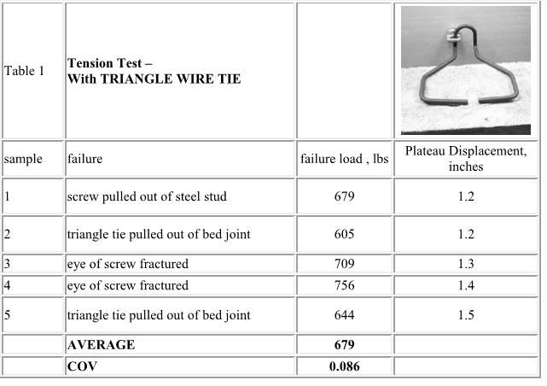
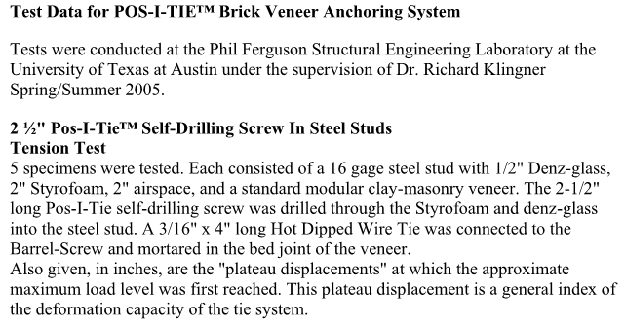
Anchor Properties
Example Manufacturer Data
What factor of safety should be applied?
Is the anchor stiffness = plateau displacement divided by the failure load?
Full Engineered Design of Anchored Veneer
4/12/2022
88

Slide 89
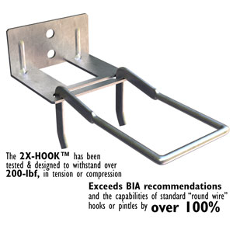

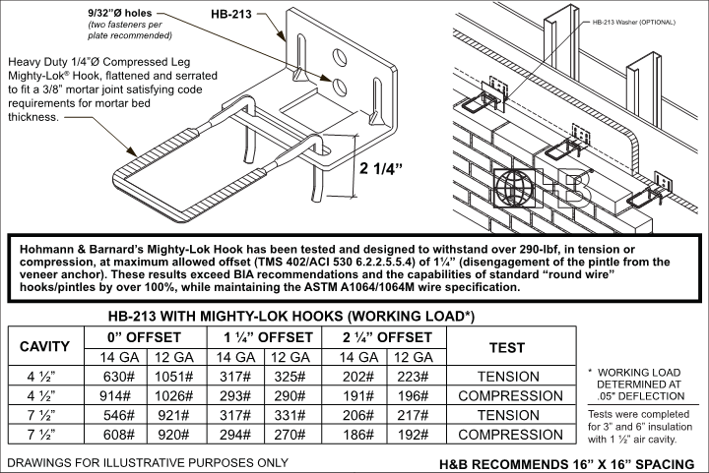
Anchor Properties
Example Manufacturer Data
Working Load provided
Based on deflection limit
What factory of safety does this represent?
What if you want to design for ultimate loads?
How many tests were done?
Was mortar joint tested?
Full Engineered Design of Anchored Veneer
4/12/2022
89

Slide 90
Behavior of Anchored Veneers
Anchor Component Behavior
Generic Properties for Adjustable 2-Leg Anchors
From Hochwalt, Bennett et al (2019)
Use for design strength, lesser of
0.5 x average ultimate strength in mid—point of adjustment
1.5 x the strength in the position of maximum offset
Allowable load = 0.6 x design strength.
Stiffness typically not reported very well. Ideally use the secant stiffness between 10 lbs and 40% of ultimate in mid-point position.
Full Engineered Design of Anchored Veneer
4/12/2022
90

Slide 91
Backing Properties
Backing Component Behavior
Material Properties
Steel Studs (AISI)
Wood Studs (NDS)
Concrete Wall (ACI 318)
Masonry Wall (TMS 402)
Serviceability Criteria - Deflection
Limit State - Strength
Full Engineered Design of Anchored Veneer
4/12/2022
91

Slide 92
Full Engineered Method - Example
Suggested Procedure
Determine Loads
Design Backing
Check Stability
Select Anchor Type
Estimate Anchor Spacing
Pseudo-Nonlinear Analysis
Verify Anchor Demands
Full Engineered Design of Anchored Veneer
4/12/2022
92

Slide 93
Full Engineered Design
Givens:
60’-0” building height
12’-0” story height
q_{z} = 28 psf
Component and Cladding Pressure = 45 psf
Seismic Design Category = D
Veneer, Connection Body = 11 psf
Fasteners = 35 psf
Full Engineered Design of Anchored Veneer
4/12/2022
93

Slide 94
Full Engineered Design
Givens:
3 ½” clay units
Type N mortar cement mortar
6” steel studs at 16” on center
Goal:
Maximize energy performance by maximizing anchor spacing
Full Engineered Design of Anchored Veneer
4/12/2022
94

Slide 95
Full Engineered Method
Suggested Procedure
Determine Loads
Design Backing
Check Stability
Select Anchor Type
Estimate Anchor Spacing
Pseudo-Nonlinear Analysis
Verify Anchor Demands
Full Engineered Design of Anchored Veneer
4/12/2022
95

Slide 96
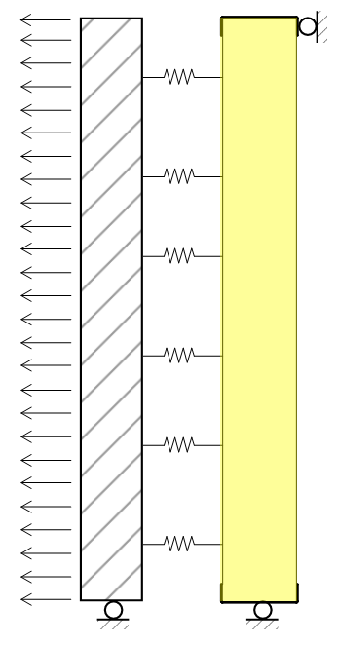
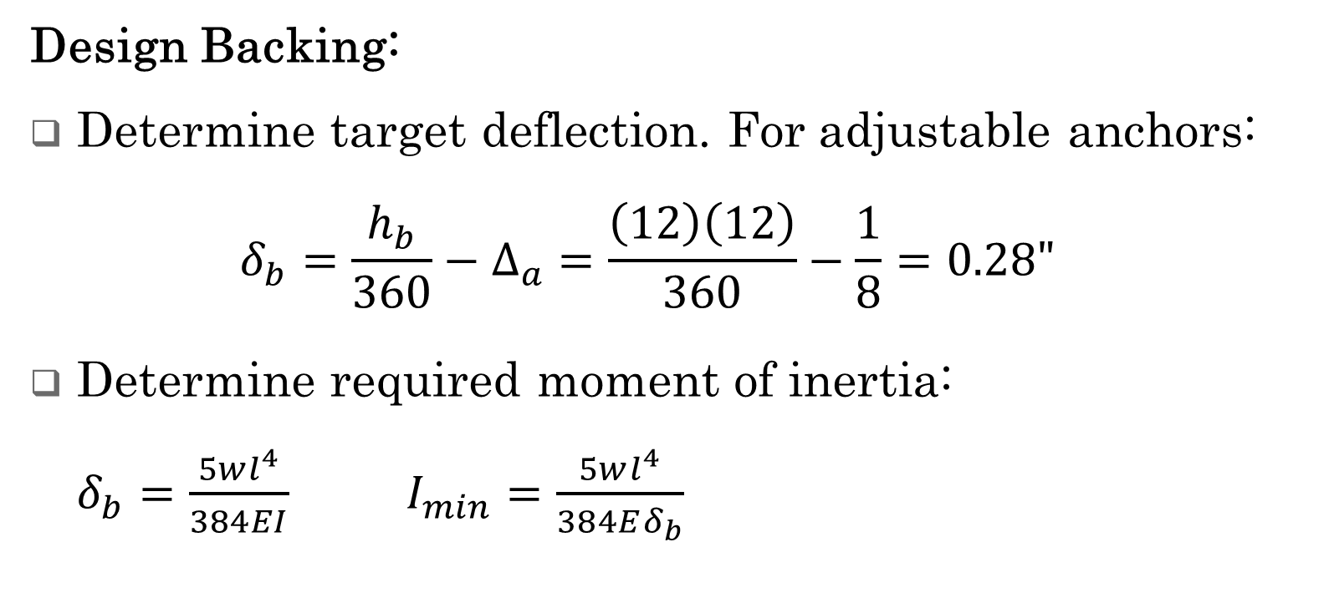
Full Engineered Design
Design Backing:
Determine target deflection. For adjustable anchors:
$$δ_{b}=\frac{h_{b}}{360}−Δ_{a}=\frac{\left(12\right)\left(12\right)}{360}−\frac{1}{8}=0.28"$$
Determine required moment of inertia:
$δ_{b}=\frac{5wl^{4}}{384EI}$ $I_{min}=\frac{5wl^{4}}{384Eδ_{b}}$
Full Engineered Design of Anchored Veneer
4/12/2022
96

Slide 97
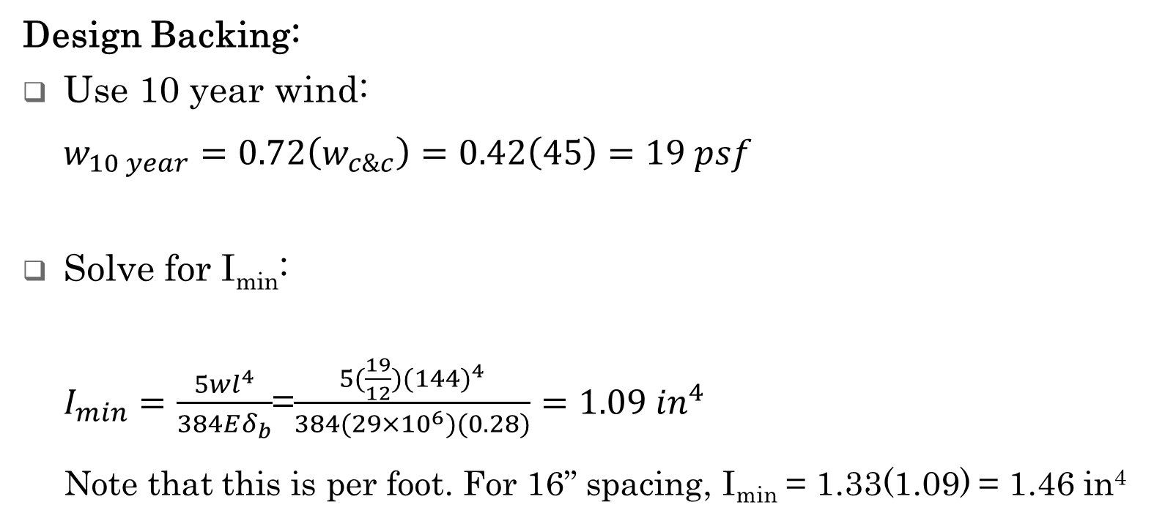
Full Engineered Design
Design Backing:
Use 10 year wind:
$$w_{10 year}=0.72\left(w_{c\&c}\right)=0.42\left(45\right)=19 psf$$
Solve for I_{min}:
$I_{min}=\frac{5wl^{4}}{384Eδ_{b}}$=$\frac{5(\frac{19}{12}){(144)}^{4}}{384(29×{10}^{6})(0.28)}=1.09 {in}^{4}$
Note that this is per foot. For 16” spacing, I_{min} = 1.33(1.09) = 1.46 in⁴
Full Engineered Design of Anchored Veneer
4/12/2022
97

Slide 98
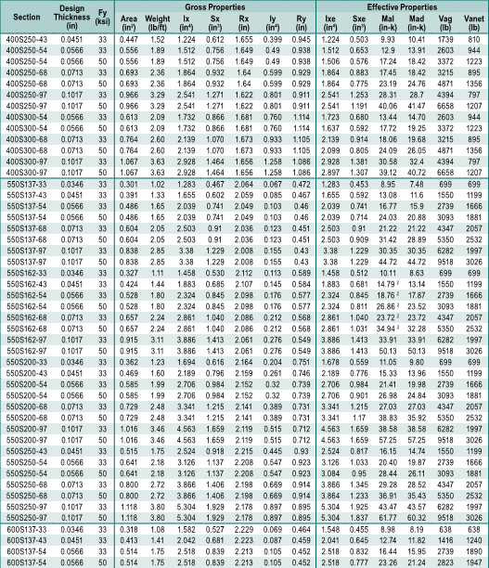
Full Engineered Design
Design Backing:
Consult SSMA Manual:
Looks like 600S137-33 might work
Full Engineered Design of Anchored Veneer
4/12/2022
98

Slide 99

Full Engineered Design
Design Backing:
Check allowable moment:
$w_{ASD}=0.6\left(w_{c\&c}\right)=0.6\left(45\right)=27 psf$
$$M_{ASD}=\frac{wl^{2}}{8}=\frac{1.33(\frac{27}{12}){(144)}^{2}}{8}=7.78 in−k$$
Still looks like 600S137-33
Full Engineered Design of Anchored Veneer
4/12/2022
99

Slide 100
Full Engineered Design
Design Backing:
Fasteners
For prescriptive designs 12.2.2.7.4 requires min thickness of 0.043 in (43 mil)
BIA Technical Note 28B also recommends 43 mil minimum
We’re going to use slotted anchors
200 lb allowable load
(2) screws; need 100 lbs per screw
Full Engineered Design of Anchored Veneer
4/12/2022
100

Slide 101

Full Engineered Design
Design Backing:
Use 600S137-43.
Note I = 2.042 in⁴
Full Engineered Design of Anchored Veneer
4/12/2022
101

Slide 102
Full Engineered Method
Suggested Procedure
Determine Loads
Design Backing
Check Stability
Select Anchor Type
Estimate Anchor Spacing
Pseudo-Nonlinear Analysis
Verify Anchor Demands
Full Engineered Design of Anchored Veneer
4/12/2022
102

Slide 103
Full Engineered Method
Check Stability
Full Engineered Design of Anchored Veneer
4/12/2022
103

Slide 104
Full Engineered Method
Check Stability
Deflection of Backing |  | Maximum value for deemed to comply
Wind¹ | Seismic² | h_{b}/t_{sp} | h_{b} for t_{sp} = 2-5/8 inch | h_{b} for t_{sp} = 3.5 inch
h_{b}/240 | h_{b}/100 | 67 | 14.6 ft | 19.5 ft
h_{b}/360 | h_{b}/150 | 100 | 21.9 ft | 29.2 ft
h_{b}/480 | h_{b}/200 | 133 | 29.1 ft | 38.8 ft
h_{b}/600 | h_{b}/250 | 167 | 36.5 ft | 48.7 ft
¹Under application of 0.42 times the strength level wind load.
²Under application of the strength level seismic load.
12’ height is OK
Full Engineered Design of Anchored Veneer
4/12/2022
104

Slide 105
Full Engineered Method
Suggested Procedure
Determine Loads
Design Backing
Check Stability
Select Anchor Type
Estimate Anchor Spacing
Pseudo-Nonlinear Analysis
Verify Anchor Demands
Full Engineered Design of Anchored Veneer
4/12/2022
105

Slide 106
Full Engineered Method
Select Anchor Type
Slotted Anchors
Want adjustable anchor to accommodate expansion of brick.
Slotted anchor has higher capacity than 2-Leg anchors
Adjustable
Design Strength:
330 lbs
Allowable Load:
200 lbs
Stiffness:
3,000 lb/in
Full Engineered Design of Anchored Veneer
4/12/2022
106

Slide 107
Full Engineered Method
Suggested Procedure
Determine Loads
Design Backing
Check Stability
Select Anchor Type
Estimate Anchor Spacing
Pseudo-Nonlinear Analysis
Verify Anchor Demands
Full Engineered Design of Anchored Veneer
4/12/2022
107

Slide 108

Full Engineered Design
Estimate Anchor Spacing:
Transverse spacing = stud spacing
Longitudinal spacing
Tributary Area Method
Prescriptive Method
Full Engineered Design of Anchored Veneer
4/12/2022
108

Slide 109
Full Engineered Design
Estimate Anchor Spacing:
Prescriptive Method
Adjustable Anchors
One anchor per 2.67 ft² (12.2.2.5.6.1)
Horizontal 32” max (12.2.2.5.6.3)
Vertical 25” max (12.2.2.5.6.3)
High Wind? No. q_{z} < 40 psf (12.2.2.12)
High Seismic? Yes. SDC D (12.2.2.12)
Reduce max area to 75%
Full Engineered Design of Anchored Veneer
4/12/2022
109

Slide 110
Full Engineered Design
Estimate Anchor Spacing:
Prescriptive Method
Area per anchor = 0.75 x 2.67 = 2.00 ft²
Horizontal spacing = stud spacing = 16”
Vertical spacing = 2.00 / 1.33 = 18”
Masonry module is 8”, we would use 16”
Full Engineered Design of Anchored Veneer
4/12/2022
110

Slide 111
Full Engineered Design
Estimate Anchor Spacing:
Since prescriptive method would require 16” spacing, try for 32” vertical spacing.
Full Engineered Design of Anchored Veneer
4/12/2022
111

Slide 112
Full Engineered Method
Suggested Procedure
Determine Loads
Design Backing
Check Stability
Select Anchor Type
Estimate Anchor Spacing
Pseudo-Nonlinear Analysis
Verify Anchor Demands
Full Engineered Design of Anchored Veneer
4/12/2022
112

Slide 113
Full Engineered Method
Model Properties
Backing
EI known for 600S137-43 studs
Anchors
Slotted anchors = 3,000 lb/in
Masonry
Stiffness, E_{m}I
Need elastic modulus, E_{m}
Strength, M_{cr} = f_{r}S
Need modulus of rupture, f_{r}
Full Engineered Design of Anchored Veneer
4/12/2022
113

Slide 114


Full Engineered Method
Model Properties
Elastic Modulus
Concrete Masonry
Clay Masonry
f’_{m} is per Unit Strength Method in TMS 602
Need unit strength
May be unknown
Full Engineered Design of Anchored Veneer
4/12/2022
114

Slide 115

Full Engineered Method
Model Properties
BIA Technical Note 3A
Full Engineered Design of Anchored Veneer
4/12/2022
115

Slide 116

Full Engineered Method
Model Properties
Assume f’_{m} = 2,500 psi $E_{m}=700{f′}_{m}=1.75×{10}^{6}$
Full Engineered Design of Anchored Veneer
4/12/2022
116

Slide 117

Full Engineered Method
Model Properties
$$M_{cr}=Sf_{r}=\frac{bt^{2}f_{r}}{6}=\frac{(16){\left(3.5\right)}^{2}(100)}{6}$$
$$M_{cr}=3,270ib−in=3.27in−k$$
Full Engineered Design of Anchored Veneer
4/12/2022
117

Slide 118



Full Engineered Method
Model Creation
Pseudo-Nonlinear
Manually insert hinges at cracks
Could do true nonlinear
Anchors
Modeled as axial elements
$$Δ=\frac{PL}{AE}$$
$$\frac{P}{Δ}=\frac{AE}{L}=k$$
$$A=\frac{kL}{E}$$
Full Engineered Design of Anchored Veneer
4/12/2022
118

Slide 119

Full Engineered Method
Model Analysis
Apply ultimate load to model
Veneer is uncracked
Max moment at midheight = 8.02 in-k
Exceeds cracking moment = 3.27 in-k
First crack will occur at midheight
Crack expected at (3.27/8.02) 45 psf = 18.3 psf
Full Engineered Design of Anchored Veneer
4/12/2022
119

Slide 120


Full Engineered Method
Model Analysis
Insert hinge at midheght to represent first crack
Max moment = 6.55 in-k
Exceeds cracking moment = 3.27 in-k
Crack expected at (3.27/6.55) 45 psf = 22.5 psf
Full Engineered Design of Anchored Veneer
4/12/2022
120

Slide 121

Full Engineered Method
Model Analysis
Insert second hinge to represent second crack
Max moment = 3.49 in-k
Exceeds cracking moment = 3.27 in-k
Crack expected at (3.27/3.49) 45 psf = 42.2 psf
Full Engineered Design of Anchored Veneer
4/12/2022
121

Slide 122

Full Engineered Method
Model Analysis
Insert third hinge to represent third crack
Max moment = 1.59 in-k
Less than cracking moment = 3.27 in-k
Condition at ultimate load has been determined
Full Engineered Design of Anchored Veneer
4/12/2022
122

Slide 123
Full Engineered Method
Model Analysis
Extract anchor forces
Max anchor force 208 lbs < 330 anchor capacity OK
Max anchor has effective tributary area:
208 lbs / 45 psf = 4.62 ft²
Physical area = 1.33 x 2.67 = 3.55
Effective tributary area = 4.62 / 3.55 = 1.3 physical tributary area
81 lbs
208 lbs
175 lbs
191 lbs
130 lbs
Full Engineered Design of Anchored Veneer
4/12/2022
123

Slide 124
Full Engineered Method
Point of Curiosity #1
Veneer: not considered to add strength or stiffness to the wall system
Ultimate loads
Max moment in backing
Without veneer = 13.0 k-in
With veneer = 13.4 k-in
Max deflection of backing
Without veneer = 0.47 in
With veneer = 0.51 in
Full Engineered Design of Anchored Veneer
4/12/2022
124

Slide 125
Full Engineered Method
Point of Curiosity #2
Veneer: not considered to add strength or stiffness to the wall system
ASD loads
Max moment in backing
Without veneer = 7.78 k-in
With veneer = 8.84 k-in
Max deflection of backing
Without veneer = 0.28 in
With veneer = 0.26 in
Assumes no previous load causing third crack
Full Engineered Design of Anchored Veneer
4/12/2022
125

Slide 126
Full Engineered Method
Point of Curiosity #3
Veneer: not considered to add strength or stiffness to the wall system
10 Year load
Max moment in backing
Without veneer = 5.44 k-in
With veneer = 6.15 k-in
Max deflection of backing
Without veneer = 0.20 in
With veneer = 0.15 in
Assumes no previous load causing second crack
Full Engineered Design of Anchored Veneer
4/12/2022
126

Slide 127
Agenda
Behavior of Anchored Veneers
Code Requirements
Prescriptive Design
Alternative Design
Full Engineered Method
Tributary Area Method

Slide 128
Tributary Area Method
Full Engineered Method is a lot of work
Is there an easier way?
Could we develop an equivalent tributary area?
Tributary Area Design of Anchored Veneer
4/12/2022
128

Slide 129

Tributary Area Method
Scenario 1:
Flexible anchors
Single crack at midheight
Center anchor takes maximum load:
F_{p} = 0.5(A_{stud})(pressure)
Or, as illustrated
F_{p} = 3(A_{trib})(pressure)
Tributary Area Design of Anchored Veneer
4/12/2022
129

Slide 130

Tributary Area Method
Scenario 2:
Masonry cracked at each anchor
Load on anchor is just based on the physical tributary area of the anchor:
F_{p} = (A_{trib})(pressure)
Tributary Area Design of Anchored Veneer
4/12/2022
130

Slide 131
Tributary Area Method
Source | Required Anchor Strength
UBC (1997) Section 1403.4.3 | Twice veneer weight of A_{t}
WSCPA (2004) | Anchor Force: T_{a} = 0.25pA_{stud} Ultimate capacity: 1.25T_{a} if k ≤ 2000 lb/in. (350 N/mm) 2.0T_{a} if k > 2000 lb/in. (350 N/mm)
AISI (2014), CSSBI (2008) | 0.4pA_{stud}, but not less than 2pA_{t}
McGinley (2010) | Stud backed system with stiff anchors: 0.25pA_{stud} Flexible/ductile anchor systems with stiff backing: pA_{t}
CSA S304.1 (2014) | Flexible backing (stiffness ≤ 2.5 uncracked veneer stiffness): 0.4pA_{stud}, but not less than 2pA_{t} Stiff backing: pA_{t}
AS 3700 (2011) | Flexible backing (stiffness ≤ 0.5 uncracked veneer stiffness): 0.2pA_{stud}; 0.4pA_{stud} top row (can use stronger anchor, or double number of anchors) Stiff backing: 1.3pA_{t}
Note: T_{a} = anchor force; p = design pressure (either wind or earthquake); A_{t} = tributary area; A_{stud} = tributary area of stud (stud spacing × stud height); k = stiffness of anchor
“Proposed Changes to the TMS 402 Anchored Veneer Provisions”, Hochwalt, Bennett, et al, Proceedings of the 13th North American Masonry Conference, 2019.
Tributary Area Design of Anchored Veneer
4/12/2022
131

Slide 132
Tributary Area Method
Parametric Study:
144 Pseudo non-linear analyses (Bennett)
Looked at varying:
Masonry stiffness and strength
Tie stiffness
Backing stiffness
Tie stiffness was most critical factor
Tributary Area Design of Anchored Veneer
4/12/2022
132

Slide 133

Tributary Area Method
Tributary Area Design of Anchored Veneer
4/12/2022
133

Slide 134
Tributary Area Method
Suggested Values
Tie Stiffness | Tie Force
k_{tie} ≤ 2500 lb/in. | 2.0p_{u}A_{t}
2500 lb/in. < k_{tie} ≤ 5000 lb/in. | 2.5p_{u}A_{t}
5000 lb/in. < k_{tie} ≤ 8000 lb/in. | 3.0p_{u}A_{t}
k_{tie} > 8000 lb/in. | 4.0p_{u}A_{t}
Tributary Area Design of Anchored Veneer
4/12/2022
134

Slide 135
Tributary Area Method
Givens:
60’-0” building height
12’-0” story height
q_{z} = 28 psf
Component and Cladding Pressure = 45 psf
Seismic Design Category = D
Veneer, Connection Body = 11 psf
Fasteners = 35 psf
Tributary Area Design of Anchored Veneer
4/12/2022
135

Slide 136
Tributary Area Method
Givens:
3 ½” clay units
Type N mortar cement Mortar
6” steel studs at 16” on center
Goal:
Maximize energy performance by maximizing anchor spacing
Tributary Area Design of Anchored Veneer
4/12/2022
136

Slide 137
Tributary Area Method
Suggested Procedure
Determine Loads – Same as Full Engineered
Design Backing – Same as Full Engineered
Check Stability – Same as Full Engineered
Select Anchor Type
Determine Anchor Spacing
Tributary Area Design of Anchored Veneer
4/12/2022
137

Slide 138
Tributary Area Method
Select Anchor Type
Slotted Anchors
Want adjustable anchor to accommodate expansion of brick.
Slotted anchor has higher capacity than 2-Leg anchors
Adjustable
Design Strength:
330 lbs
Allowable Load:
200 lbs
Stiffness:
3,000 lb/in
Tributary Area Design of Anchored Veneer
4/12/2022
138

Slide 139

Tributary Area Method
Determine Anchor Spacing
Tie Stiffness | Tie Force
k_{tie} ≤ 2500 lb/in. | 2.0p_{u}A_{t}
2500 lb/in. < k_{tie} ≤ 5000 lb/in. | 2.5p_{u}A_{t}
5000 lb/in. < k_{tie} ≤ 8000 lb/in. | 3.0p_{u}A_{t}
k_{tie} > 8000 lb/in. | 4.0p_{u}A_{t}
$$F_{cap}=2.5p_{u}A_{t}$$
$$A_{t,max}=\frac{F_{cap}}{2.5p_{u}}=\frac{330}{2.5(45)}=2.93 {ft}^{2}$$
16” x 24” Spacing
Tributary Area Design of Anchored Veneer
4/12/2022
139

Slide 140
Tributary Area Method
Comparison of Anchor Spacings
Prescriptive: 16” x 16”
Tributary Area Method: 16” x 24”
1/3 reduction in anchors / thermal bridging
Full Engineered Method: 16” x 32”
1/2 reduction in anchors / thermal bridging
Tributary Area Design of Anchored Veneer
4/12/2022
140

Slide 141

Anchored Veneer Close
Special Inspection / Quality Assurance
Chapter 12 (veneer) is in Part 4
Recommend treating engineered veneers as if they were in Part 3.
Tributary Area Design of Anchored Veneer
4/12/2022
141

Slide 142
Anchored Veneer Close
Resources
Anchors
BIA Technical Note 44B
NCMA TEK 12-01B
“Proposed Changes to the TMS 402 Anchored Veneer Provisions”, Hochwalt, Bennett, et al, Proceedings of the 13th North American Masonry Conference, 2019
Tributary Area Design of Anchored Veneer
4/12/2022
142

Slide 143
Anchored Veneer Close
Concrete Masonry Backing
BIA Technical Note 28
Concrete Masonry Veneers
NCMA TEK 03-06C
NCMA TEK 05-02A
Jointing of Veneers
BIA Technical Note 18A
NCMA TEK 10-04
Tributary Area Design of Anchored Veneer
4/12/2022
143

Slide 144
Anchored Veneer Close
Lintels
BIA Technical Note 31B
Tide, R.H.R and N.V. Krogstad, 1993, “Economical Design of Shelf Angles,” Proceedings of the Symposium on Masonry: Design and Construction, Problems and Repair, STP 1180, American Society for Testing and Materials, Philadelphia, PA.
Steel Stud Backing
AISI Brick Veneer Cold-Formed Steel Framing Design Guide
BIA Technical Note 28B
WSCPA “Design Guide for Anchored Brick Veneer over Steel Studs” Available now at www.brick-wscpa.org
Tributary Area Design of Anchored Veneer
4/12/2022
144

Slide 145
Anchored Veneer Close
Steel Stud Backing (continued)
“Addressing Maximum Design Deflection for Cold-Formed Steel Framing When Used as a Backing for Brick Veneer ”, Clark, Fried, Byra, Masonry 2018, ASTM STP1612, 2018.
Structural Brick Veneer
BIA Technical Note 41
WSCPA “Design Guide for Structural Brick Veneer”
Wood Stud Backing
BIA Technical Note 28
BIA, Brick Brief, “Designing Anchored Brick Veneer Above 30 Feet with a Backing of Wood Framing”, 2015.
Wood Products Council, “Options for Brick Veneer on Mid-Rise Wood-Frame Buildings”, 2015.
Tributary Area Design of Anchored Veneer
4/12/2022
145

Slide 146
Adhered Veneer

Slide 147


Adhered Veneer Assembly
Image from imiweb.org
Adhered Veneer
4/12/2022
147

Slide 148

Adhered Veneer Assembly
Image from imiweb.org
Adhered Veneer
4/12/2022
148

Slide 149
Agenda
Behavior of Adhered Veneers
Code Requirements
Prescriptive Design
Alternative Design

Slide 150
Agenda
Behavior of Adhered Veneers
Code Requirements
Prescriptive Design
Alternative Design

Slide 151
2018 International Building Code
1402.3 Structural
Designed and constructed to resist Chapter 16 loads
1403.4 Masonry
“Masonry units, mortar, and metal accessories used in anchored and adhered veneer shall meet the physical requirements of Chapter 21.”
Code Requirements for Adhered Veneer
4/12/2022
151

Slide 152
2018 International Building Code
1404.2 Weather protection
Table 1404.2 Minimum thickness of weather coverings:
Architectural cast stone: ¾ in.
Other: ¼ in.
Code Requirements for Adhered Veneer
4/12/2022
152

Slide 153
2018 International Building Code
1404.10 References TMS 402 for adhered veneer provisions.
1404.10.1 Exterior adhered masonry veneer
Water resistive barriers
Flashing
Clearances – at stud walls
Image from imiweb.org
Code Requirements for Adhered Veneer
4/12/2022
153

Slide 154

2018 International Building Code
1404.10.1.4 Lath and mortar installation
1404.10.1.5 Installation directly to masonry or concrete
Image from imiweb.org
Code Requirements for Adhered Veneer
4/12/2022
154

Slide 155
2018 International Building Code
Chapter 16
Table 1604.3 Deflection limits
1609.1.1 References ASCE 7 for wind loads
1613.1 References ASCE 7 for seismic loads
Code Requirements for Adhered Veneer
4/12/2022
155

Slide 156
2018 International Building Code
Table 1604.3
Deflection Limits
Construction | L or Lr | S or W^{f} | D + L
Exterior Walls:
With Plaster or stucco finishes | - | l/360 | -
With other brittle finishes | - | l/240 | -
With flexible finishes | - | l/120 | -
^{f}The wind load shall be permitted to be taken as 0.42 times the “component and cladding” load or directly calculated using the 10-year mean return interval wind speed for the purpose of determining deflection limits in Table 1604.3. Where framing members support glass, the deflection limit therein shall not exceed that specified in Section 1604.3.7.
Code Requirements for Adhered Veneer
4/12/2022
156

Slide 157
2018 International Building Code
Chapter 21 Masonry
2101 General
2101.2.1 directs user back to Chapter 14 for design of veneers.
Code Requirements for Adhered Veneer
4/12/2022
157

Slide 158
2018 International Building Code
2103 Materials
2103.1 Masonry units
Concrete, clay, and stone per TMS 602 Article 2.3
Architectural cast stone per ASTM C1364 and TMS 504
Adhered manufactured stone veneer units per ASTM C1670
Code Requirements for Adhered Veneer
4/12/2022
158

Slide 159
2018 International Building Code
2103 Materials
2103.2.4 Mortar for adhered masonry veneer
ASTM C270 Type N or S
ANSI A118.4 for latex modified mortar.
Code Requirements for Adhered Veneer
4/12/2022
159

Slide 160
TMS 402/602 - 16
Code Requirements for Adhered Veneer
4/12/2022
160

Slide 161
TMS 402-16
Organization of Chapter 12
12.1 General
12.2 Anchored Veneer
12.2.1 Alternate (Rational) Design
12.2.2 Prescriptive
12.3 Adhered Veneer
Code Requirements for Adhered Veneer
4/12/2022
161

Slide 162
TMS 402-16
12.1 General
Not required to define or test f’_{m}
12.1.6
Addresses control of water
Design and detail veneer to accommodate differential movement.
Code Requirements for Adhered Veneer
4/12/2022
162

Slide 163
TMS 602-16
Article 2.1 Mortar
No special reference for adhered
Per IBC
Article 2.3 Masonry units
Concrete, clay and stone units – numerous ASTM’s
Reminder:
Cast stone per IBC (no conflict)
Adhered manufactured stone per IBC (no conflict)
Code Requirements for Adhered Veneer
4/12/2022
163

Slide 164

Suggested for TMS 602-22
Limit backing deflection to $h_{b}/360$ under 0.42 strength level wind load, or $h_{b}/150$ under strength level seismic load.
Limit cracking
Maintain stability
Code Requirements for Adhered Veneer
4/12/2022
164

Slide 165
Quality Assurance
TMS 402
TMS 602
Table 3 – Verification
Prior to construction, verification of compliance of submittals.
Table 4 – Special Inspection
Only required in Risk Category IV
Design professional can choose to exceed these minimums
Code Requirements for Adhered Veneer
4/12/2022
165

Slide 166
Agenda
Behavior of Adhered Veneers
Code Requirements
Prescriptive Design
Alternative Design

Slide 167
Prescriptive Design – TMS 402-16
General Requirements
TMS 402-16 Provisions are outdated (1967)
Type S mortar applied directly to concrete or masonry
Most adhered veneers constructed using industry recommendations
No restrictions on use
Prescriptive Design of Adhered Veneers
4/12/2022
167

Slide 168
Prescriptive Design – TMS 402-16
General Requirements
12.3.2.1 Unit sizes
2-5/8” maximum thickness
36” maximum unit dimension
5 psf max area
15 psf max weight
Prescriptive Design of Adhered Veneers
4/12/2022
168

Slide 169
Prescriptive Design – TMS 402-16
12.3.2.2 Wall area limitations
Just as required to accommodate differential movements
12.3.2.3 Backing – moisture resistant and any of:
Masonry
Concrete
Lath and plaster applied to masonry, concretem steel framing, wood framing
Prescriptive Design of Adhered Veneers
4/12/2022
169

Slide 170
Prescriptive Design – TMS 402-16
12.3.2.4 Adhesion, either:
Shear strength of 50 psi when tested per ASTM C482, or
Comply with TMS 602 Article 3.3 C.
Developed in early 1950’s
Uses Type S mortar
How does this relate to IBC installation requirements?
Prescriptive Design of Adhered Veneers
4/12/2022
170

Slide 171
Prescriptive Design – TMS 402-22
Expected to
Recognize multiple types of backing
Recognize modern setting bed mortars:
ANSI 118.4 – Modified Dry Set Cement Mortar
Formerly: Latex Portland Cement Mortar
ASTM 118.15 – Improved Modified Dry-Set Cement Mortar
Place limits on applications, including 60 feet max height.
Prescriptive Design of Adhered Veneers
4/12/2022
171

Slide 172

Prescriptive Design – TMS 402-22
Sample Table for Prescriptive Design (other than concrete or masonry backing)
Prescriptive Design of Adhered Veneers
4/13/2022
172

Slide 173
Agenda
Behavior of Adhered Veneers
Code Requirements
Prescriptive Design
Alternative Design

Slide 174
Anchored Veneer Close
Resources
Adhered Veneers
BIA Technical Note 28C
“Proposed Changes to the TMS 402 Adhered Veneer Provisions”, Thompson, Clark, et al, Proceedings of the 13th North American Masonry Conference, 2019
“Initial Design Method for Thin Masonry Veneers Individually Secured by Mortar Adhesion”, Hagel, M., Isfeld, Al., and Rizaee, S. 13th Canadian Masonry Symposium, Halifax, CA, 2017.
Installation Guide and Detailing Options for Compliance with ASTM C1780 For Adhered Manufactured Stone Veneer 5th Edition, 4th Printing, National Concrete Masonry Association, 2020.
Adhered Veneer
4/12/2022
174

Slide 175
Thanks!
John.Hochwalt@kpff.com

