Slide 1
Masonry Wall Openings

Slide 2
Outline
Effect of Openings on Behavior
Joints
Out-of-Plane
In-Plane
Vertical
Lateral

Slide 3
Openings and Joints
Defining the problem . . .
Choosing the problem

Slide 4

Agenda
When Are Joints Required?
Where Can Joints be Located?
How Can Joints be Constructed?

Slide 5
Code Requirements
TMS 402-16
Code
4.1.5 Other effects
Consideration shall be given to effects of forces and deformations due to prestressing, vibrations, impact, shrinkage, expansion, temperature changes, creep, unequal settlement of supports, and differential movement.
When Are Joints Required?
4/12/2022
5

Slide 6
Code Requirements
TMS 402-16
Commentary
4.1.5 Other effects
Loads are not the sole source of stresses. The structure may also resist forces from the sources listed. The nature and extent of some of these forces may be greatly influenced by the choice of materials, structural connections, and geometric configuration.
When Are Joints Required?
4/12/2022
6

Slide 7
Code Requirements
TMS 402-16
Code
4.2 — Material properties
4.2.1 General
Unless otherwise determined by test, the following moduli and coefficients shall be used in determining the effects of elasticity, temperature, moisture expansion, shrinkage, and creep.
When Are Joints Required?
4/12/2022
7

Slide 8
Code Requirements
TMS 402-16
Commentary
4.2 — Material properties
4.2.1 General
Proper evaluation of the building material movement from all sources is important to masonry design. Clay masonry and concrete masonry may behave quite differently under normal loading and weather conditions. The Committee has extensively studied available research information in the development of these material properties. The designer is encouraged to review industry standards for further design information and movement joint locations. Material properties can be determined by appropriate tests of the materials to be used.
When Are Joints Required?
4/12/2022
8

Slide 9
National Recommendations
National Concrete Masonry Association TEK Notes:
Section 10 - Movement Control
10-01A Crack Control in Concrete Masonry Walls
10-02D Control Joints for Concrete Masonry Walls – Empirical Method
10-03 Control Joints for Concrete Masonry Walls – Alternative Engineered Method
When Are Joints Required?
4/12/2022
9

Slide 10
TEK Note 10-01A
Source of Movements:
Shrinkage
0.24 to 0.54 in. per 100 feet
Temperature
Small effect in Hawaii?
Carbonation (also a shortening movement)
0.30 in. per 100 feet
When Are Joints Required?
4/12/2022
10

Slide 11
TEK Note 10-01A
How to address these effects?
Movement Joints
Additional Reinforcement
When Are Joints Required?
4/12/2022
11

Slide 12
TEK Note 10-02D Empirical Method
How to address these effects?
Movement Joints
Additional Reinforcement
When Are Joints Required?
4/12/2022
12

Slide 13
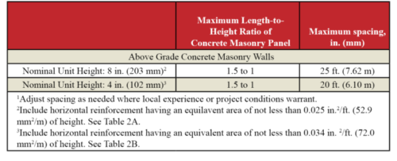
TEK Note 10-02D Empirical Method
When Are Joints Required?
4/12/2022
13

Slide 14
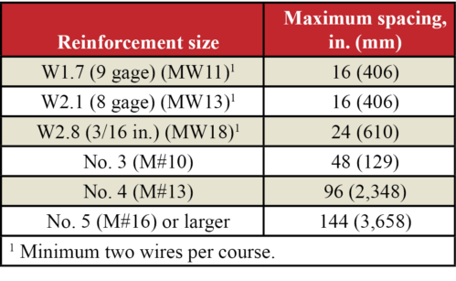
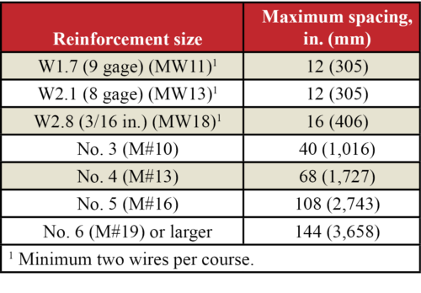
TEK Note 10-02D Empirical Method
Full Height Units
Half Height Units
Partial Height Units
When Are Joints Required?
4/12/2022
14

Slide 15
TEK Note 10-02D Alternative Method
Allows:
Increased joint spacing with increased reinforcement
Elimination of joints with even more reinforcement
When Are Joints Required?
4/12/2022
15

Slide 16
TEK Note 10-02D Alternative Method
Crack Control Coefficient, sum of :
Linear drying shrinkage
Based on testing units per ASTM C426
Use 50% of tested value per TMS 402
Due to limit in ASTM C426, 0.00033 in/in
Carbonation
No test method, assume 0.00025 in/in
When Are Joints Required?
4/12/2022
16

Slide 17
TEK Note 10-02D Alternative Method
Thermal
Per TMS 402: Coefficient of thermal expansion = 0.000004 in./in./°F
Shrinkage movement, so interested in coldest temperature
Honolulu
52 degrees in 1969
Suggests ~30 degrees
0.000004 x 30 = 0.00012 in/in
Total = 0.00033 + 0.00025 + 0.00012 = 0.0007 in/in
~3/4” in 100 foot long wall
When Are Joints Required?
4/12/2022
17

Slide 18
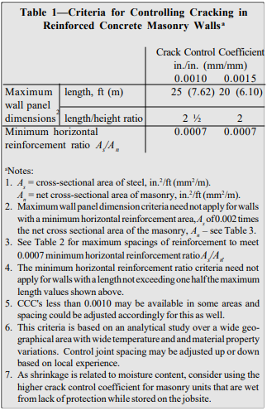
TEK Note 10-02D Alternative Method
When Are Joints Required?
4/12/2022
18

Slide 19
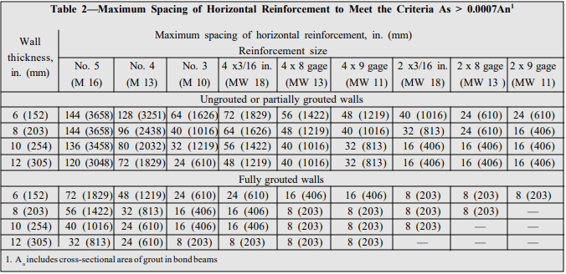
TEK Note 10-02D Alternative Method
When Are Joints Required?
4/12/2022
19

Slide 20
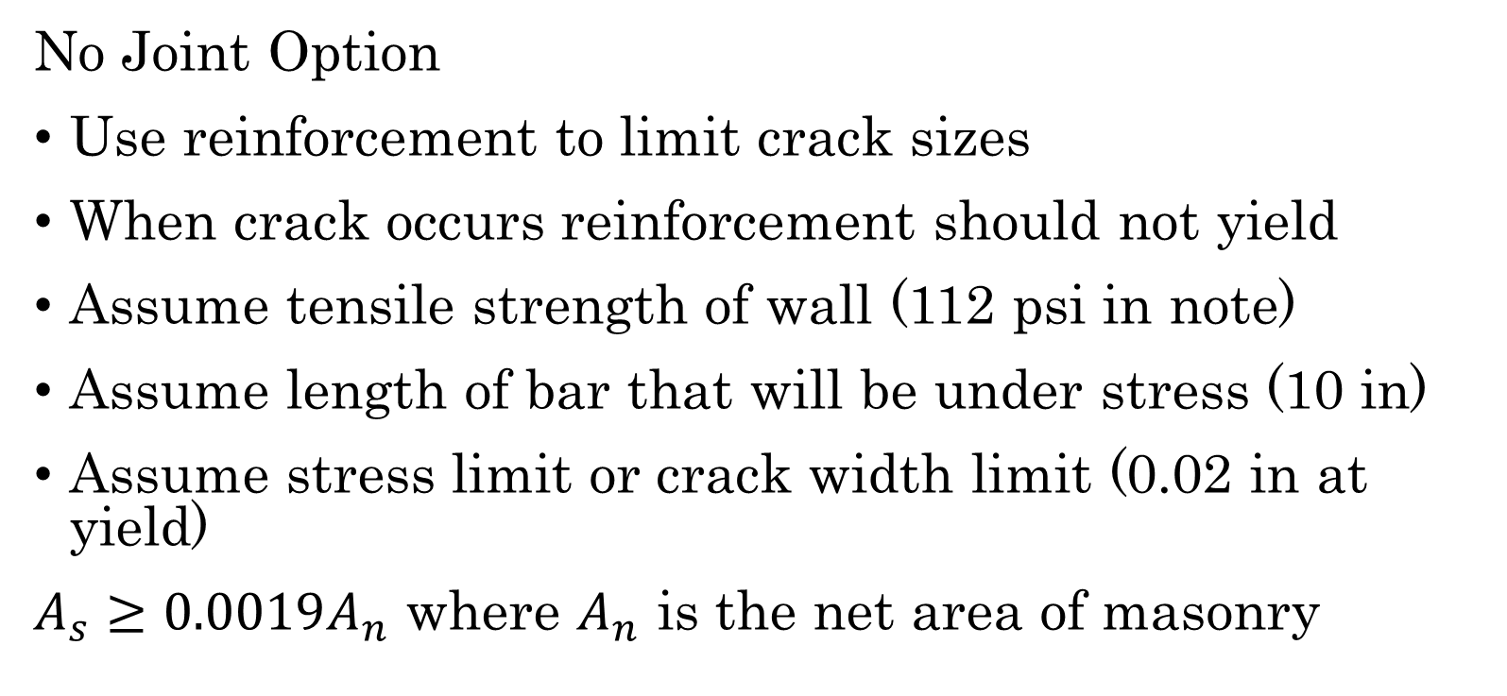
TEK Note 10-02D Alternative Method
No Joint Option
Use reinforcement to limit crack sizes
When crack occurs reinforcement should not yield
Assume tensile strength of wall (112 psi in note)
Assume length of bar that will be under stress (10 in)
Assume stress limit or crack width limit (0.02 in at yield)
$A_{s}≥0.0019A_{n}$ where $A_{n}$ is the net area of masonry
When Are Joints Required?
4/12/2022
20

Slide 21
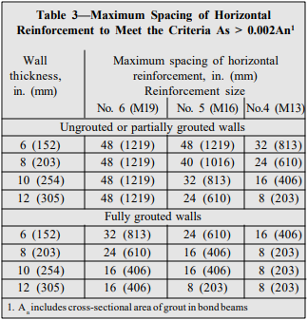
TEK Note 10-02D Alternative Method
When Are Joints Required?
4/12/2022
21

Slide 22
Agenda
When Are Joints Required?
Where Can Joints be Located?
How Can Joints be Constructed?

Slide 23
TEK Note 10-02D Empirical Method
Where to locate joints:
at changes in wall height,
at changes in wall thickness, such as at pipe and duct chases and pilasters,
at (above) movement joints in foundations and floors,
at (above and below) movement joints in roofs and floors that bear on a wall,
near one or both sides of door and window openings, and
adjacent to corners of walls or intersections within a distance equal to half the control joint spacing
Where to Locate Joints
4/12/2022
23

Slide 24
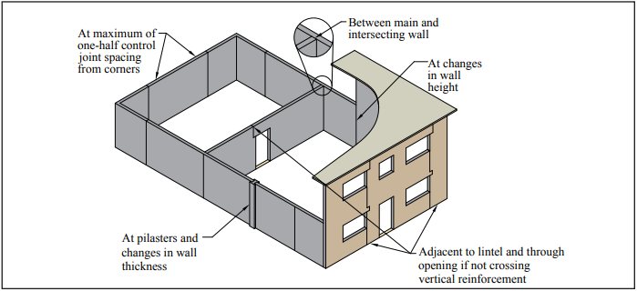
TEK Note 10-02D Empirical Method
Where to Locate Joints
4/12/2022
24

Slide 25
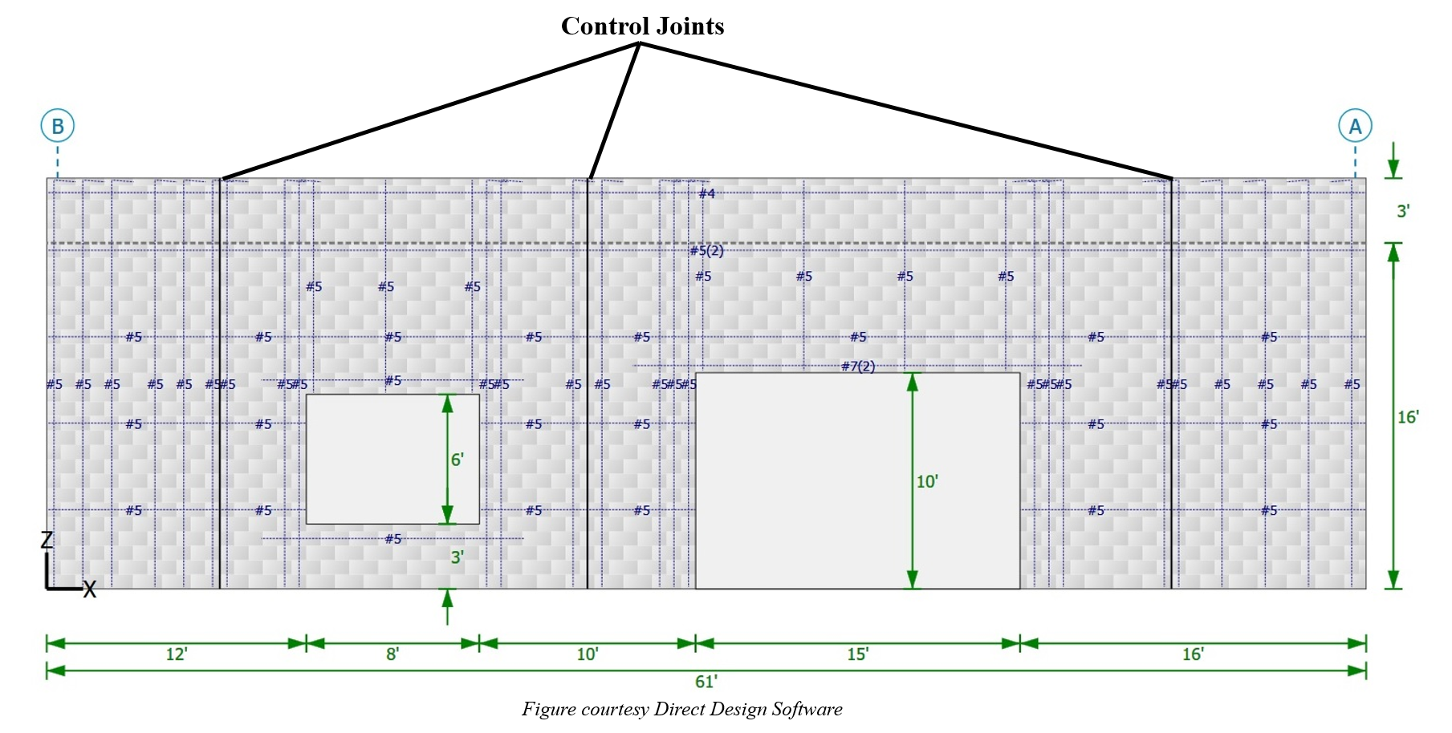
TEK Note 10-02D Empirical Method
Where to Locate Joints
4/12/2022
25

Slide 26
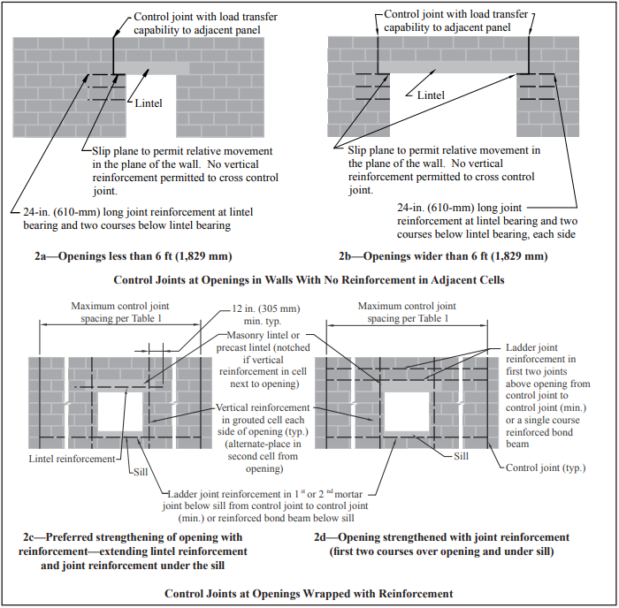
TEK Note 10-02D Empirical Method
Where to Locate Joints
4/12/2022
26

Slide 27
TEK Note 10-02D Empirical Method
Where to Locate Joints
4/12/2022
27

Slide 28
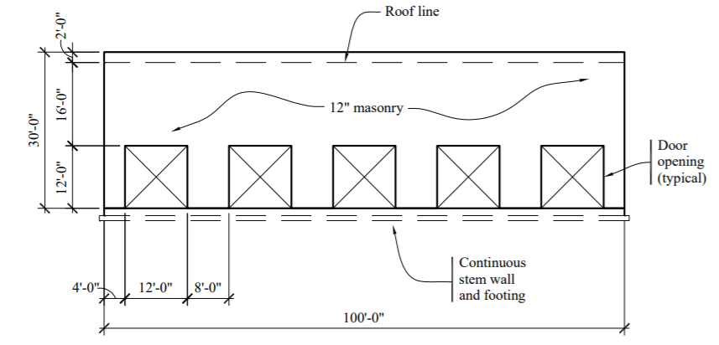
Selecting Joint Locations
Example from TMS Strength Design of Masonry
Where to Locate Joints
4/12/2022
28

Slide 29
Selecting Joint Locations
Where to Locate Joints
4/12/2022
29

Slide 30
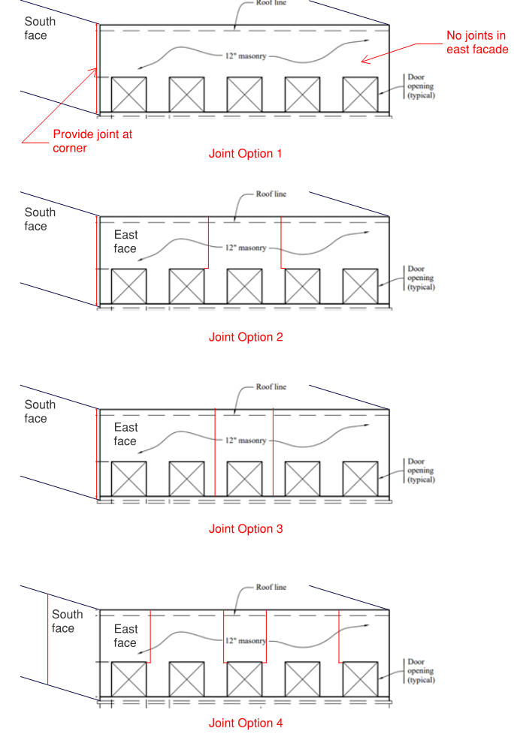
Selecting Joint Locations
Where to Locate Joints
4/12/2022
30

Slide 31
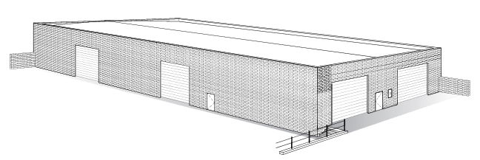
Where should the joints be?
Image from masonrybc.org
Example from MIA Reinforced Masonry Engineering Handbook
Where to Locate Joints
4/12/2022
31

Slide 32
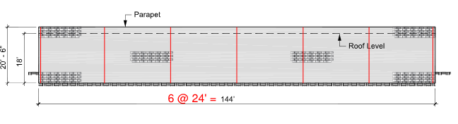
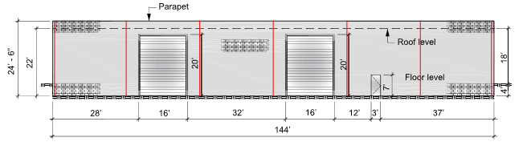
Where should the joints be?
Image from masonrybc.org
Where to Locate Joints
4/12/2022
32

Slide 33
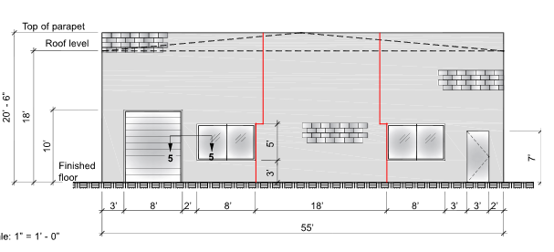
Where should the joints be?
Image from masonrybc.org
Where to Locate Joints
4/12/2022
33

Slide 34
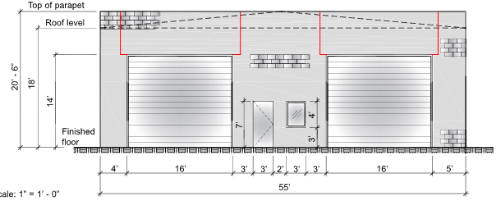
Where should the joints be?
Image from masonrybc.org
Where to Locate Joints
4/12/2022
34

Slide 35
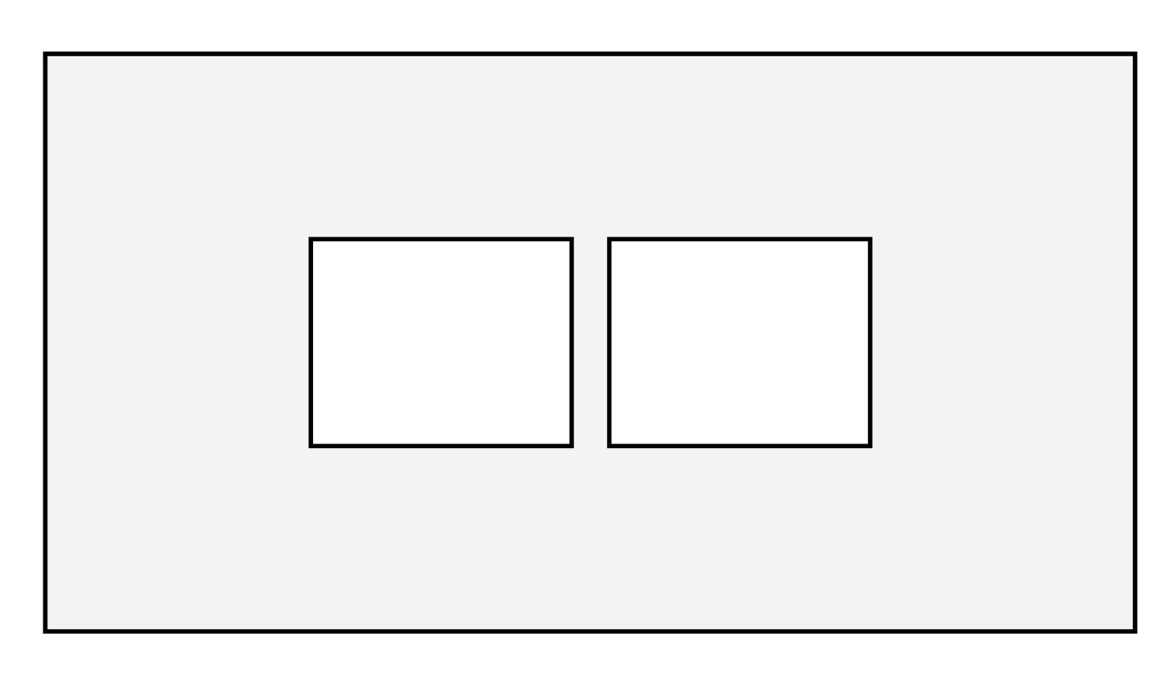
Narrow Piers
Issue:
If special wall, vertical reinforcement required to be placed at 1/3 the width of the pier
Where to Locate Joints
4/12/2022
35

Slide 36
Narrow Piers
A potential solution:
Use a joint to make the pier non-participating.
Design beam to span width of two openings
Do you need actually need the joint?
Where to Locate Joints
4/12/2022
36

Slide 37
Narrow Piers
TMS 402-16:
7.3.1 Nonparticipating elements — Masonry elements that are not part of the seismic-force-resisting system shall be classified as nonparticipating elements and shall be isolated in their own plane from the seismic-force-resisting system except as required for gravity support. Isolation joints and connectors shall be designed to accommodate the design story drift.
Where to Locate Joints
4/12/2022
37

Slide 38
Narrow Piers
TMS 402-22 Preview:
Exception: Isolation is not required if a deformation compatibility analysis demonstrates that the non-participating element can accommodate the inelastic story drift, Δ, of the structure in a manner complying with the requirements of this Code. Elements supporting gravity loads in addition their self-weight shall be evaluated for gravity load combinations of (1.2D + 1.0L + 0.15S) or 0.9D, whichever is critical, acting simultaneously with the inelastic displacement and shall have a ductility compatible with the ductility of the seismic-force -resisting system. The influence of any non-isolated nonparticipating elements on the seismic-force-resisting system shall be considered in design in accordance with Section 4.1.6 of this code.
Where to Locate Joints
4/12/2022
38

Slide 39
Agenda
When Are Joints Required?
Where Can Joints be Located?
How Can Joints be Constructed?

Slide 40
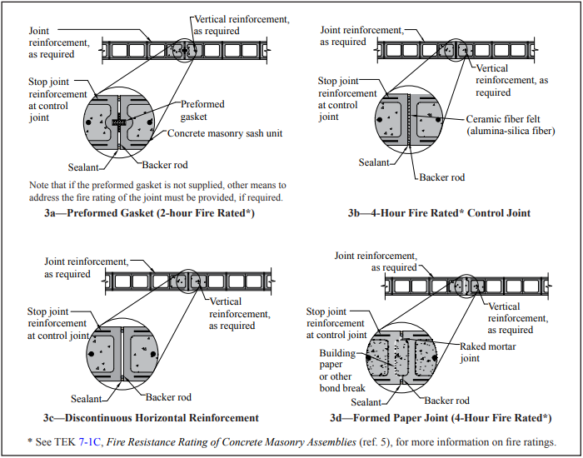
TEK Note 10-02D Suggested Joints
Fire Rated Joints – No Load Transfer
Fire Rated Joints – No Load Transfer
When Are Joints Required?
4/12/2022
40

Slide 41
TEK Note 10-02D Suggested Joints
Fire Rated Joints – No Load Transfer
When Are Joints Required?
4/12/2022
41

Slide 42
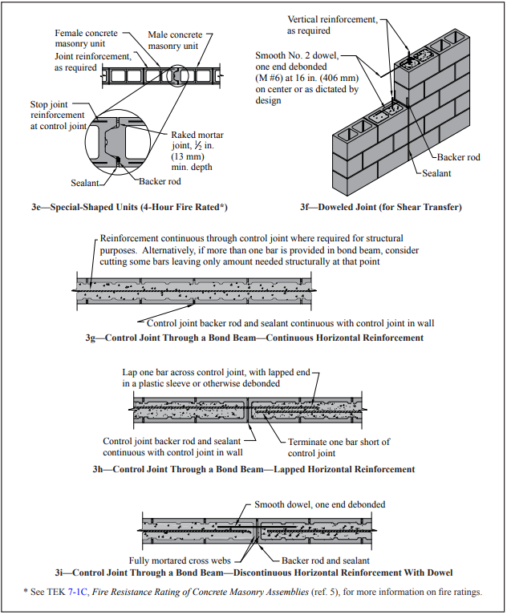
TEK Note 10-02D Suggested Joints
Joints with Load Transfer
When Are Joints Required?
4/12/2022
42

Slide 43
TEK Note 10-02D Suggested Joints
Fire Rated Joints – No Load Transfer
When Are Joints Required?
4/12/2022
43

Slide 44
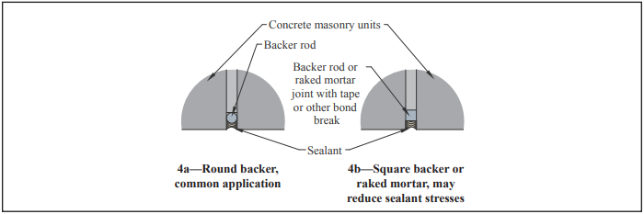
TEK Note 10-02D Suggested Joints
Sealant at Joint
When Are Joints Required?
4/12/2022
44

Slide 45
Out-of-Plane Behavior and Design

Slide 46
Agenda
Behavior
Code Requirements
Reinforcing Congestion Limits
Pilasters
P-Delta (Strength Design)

Slide 47
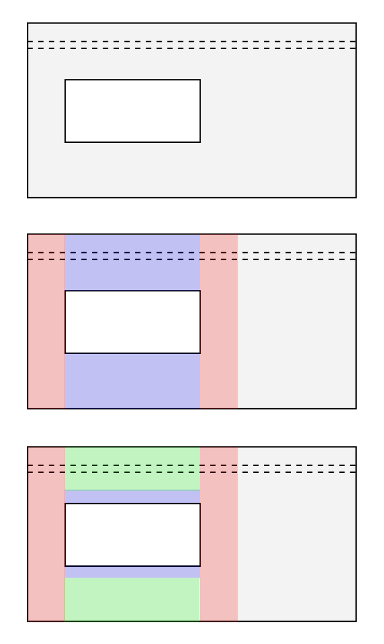
Out-of-Plane Behavior at Opening
Consider this opening:
Out-of-Plane Behavior and Design
4/12/2022
47

Slide 48
Out-of-Plane Behavior at Opening
Simple Model
Jamb regions span vertically
Head and sill regions span horizontally.
Ignores restraint from foundation and roof.
Out-of-Plane Behavior and Design
4/12/2022
48

Slide 49
Out-of-Plane Behavior at Opening
How wide can jambs be?
Treat behavior similar to width of compression block that a single bar can mobilize
TMS 402-16 Section 5.1.2
If laid in running bond + bond beams at 48”: 6 x wall thickness
If not, width of unit
Treat as effective flange width?
TMS 402-16 Section 5.1.1.2.3
6 x nominal flange thickness
Do a finite element analysis . . . Hard to capture anisotropy
Out-of-Plane Behavior and Design
4/12/2022
49

Slide 50
Out-of-Plane Behavior at Opening
How long is span of head and sill region?
Must span to center of jamb regions
Design as simple span.
Out-of-Plane Behavior and Design
4/12/2022
50

Slide 51
Out-of-Plane Behavior at Opening
Complex model
Recognizes restraint of roof and floor
Head and sills span horizontally
Head and sill regions span vertically
Like a framed opening
Out-of-Plane Behavior and Design
4/12/2022
51

Slide 52
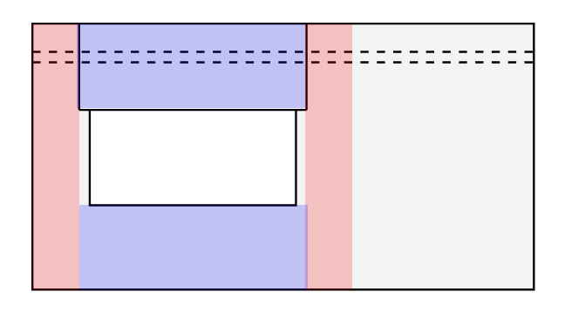
Out-of-Plane Behavior at Opening
What if we have control joints?
Jambs slide over.
Out-of-Plane Behavior and Design
4/12/2022
52

Slide 53
Agenda
Behavior
Code Requirements
Reinforcing Congestion Limits
Pilasters
P-Delta (Strength Design)

Slide 54
What limits the reinforcing?
Size of Reinforcement
Thickness of Wall
Size of the Grout Space
Design Limits
Out-of-Plane Behavior and Design
4/12/2022
54

Slide 55
Size of reinforcement
#11 maximum for ASD (TMS 6.1.2.1)
#9 maximum for SD (TMS 9.3.3.1 (a) )
Out-of-Plane Behavior and Design
4/12/2022
55

Slide 56
Thickness of wall
Nominal bar diameter shall not exceed 1/8 of the least nominal member dimension (TMS 6.1.2.5)
8” nominal wall thickness - #8 maximum.
Out-of-Plane Behavior and Design
4/12/2022
56

Slide 57
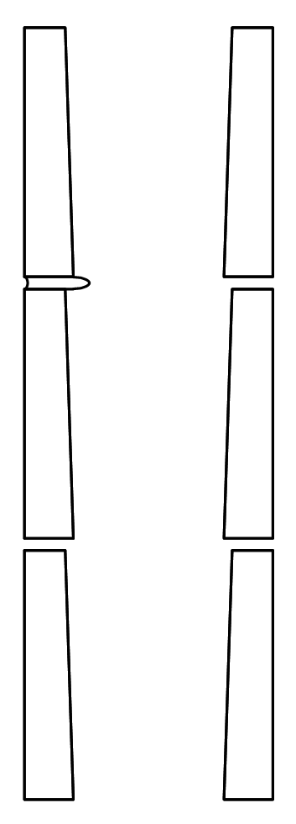
Size of grout space
Available grout space limited by:
Taper of cores (assume ¼”)
Protrusion of mortar (NCMA assumes ½”)
Misalignment of cores in running bond.
Gross grout space does not include mortar.
Net grout space includes mortar.
Out-of-Plane Behavior and Design
4/12/2022
57

Slide 58
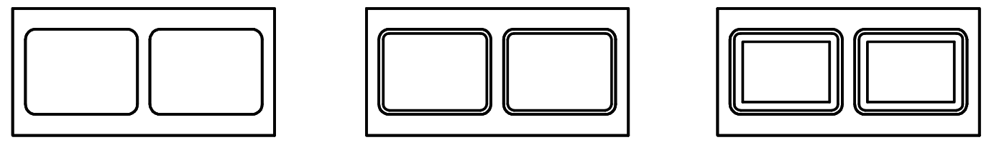
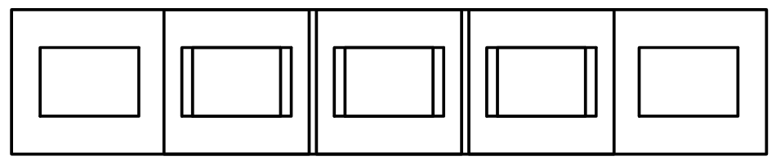
Size of grout space
Unit
With Taper
With Mortar
Running Bond
Out-of-Plane Behavior and Design
4/12/2022
58

Slide 59
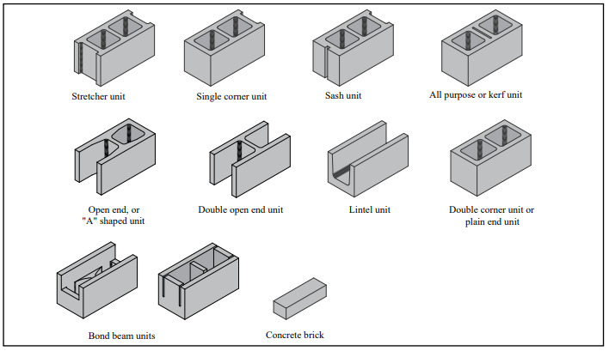
Size of grout space
Out-of-Plane Behavior and Design
4/12/2022
59

Slide 60
Size of grout space
Gross Grout Space – Running Bond
Unit Type | Core Width | Core Length | Core Area
Regular | 4.625 | 5.625 | 26.0
Stretcher | 4.625 | 3.875 | 17.9
Open End | 4.625 | 7.25 | 31.2
Gross Grout Space – Stack Bond
Unit Type | Core Width | Core Length | Core Area
Regular | 4.625 | 6.188 | 28.6
Stretcher | 4.625 | 5.188 | 24.0
Open End | 4.625 | 7.375 | 34.1
Out-of-Plane Behavior and Design
4/12/2022
60

Slide 61
Size of grout space
¼” clear between reinforcing and unit if fine grout used, ½” if coarse grout used (assume coarse grout) (TMS 6.1.3.5)
ASD:
One-half of the least clear dimension of the cell. (TMS 6.1.2.2)
Area of the vertical reinforcement ≤ 6% of the grout space (TMS 6.1.2.4)
SD
One-quarter of the least clear dimension of the cell. (TMS 9.3.3.1 (a) )
Area of the vertical reinforcement ≤ 4% of the grout space (TMS 9.3.3.1 (a) )
Out-of-Plane Behavior and Design
4/12/2022
61

Slide 62
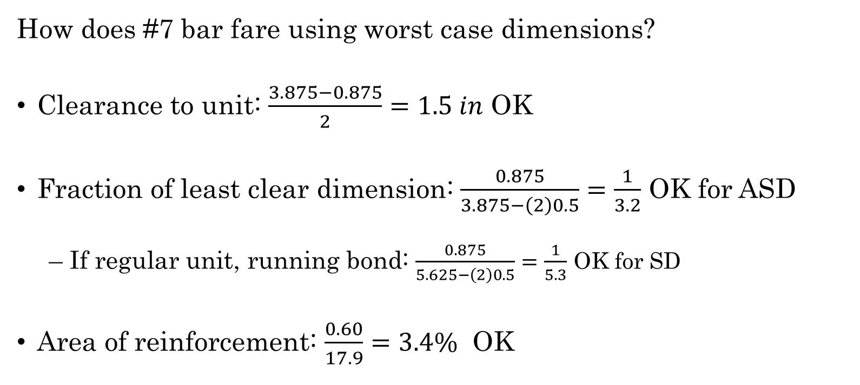
Size of grout space
How does #7 bar fare using worst case dimensions?
Clearance to unit: $\frac{3.875−0.875}{2}=1.5 in$ OK
Fraction of least clear dimension: $\frac{0.875}{3.875−\left(2\right)0.5}=\frac{1}{3.2}$ OK for ASD
If regular unit, running bond: $\frac{0.875}{5.625−\left(2\right)0.5}=\frac{1}{5.3}$ OK for SD
Area of reinforcement: $\frac{0.60}{17.9}=3.4\%$ OK
Out-of-Plane Behavior and Design
4/12/2022
62

Slide 63
Agenda
Behavior
Code Requirements
Reinforcing Congestion Limits
Pilasters
P-Delta (Strength Design)

Slide 64
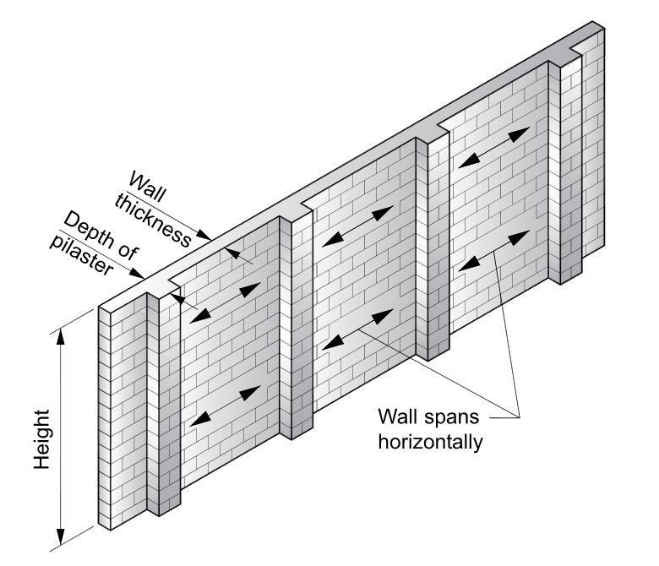
Pilasters for Opening Support
TMS 402 Definition (TMS 2.2)
Pilaster - A vertical member, built integrally with a wall, with a portion of its cross section typically projecting from one or both faces of the wall.
Use
Stiffening / extra capacity at openings
Figure from RMEH
Out-of-Plane Behavior and Design
4/12/2022
64

Slide 65
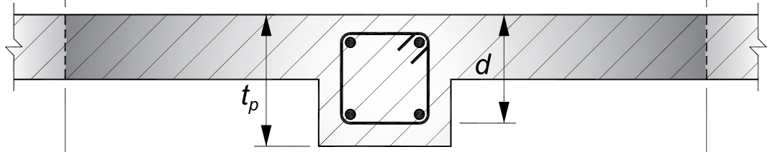
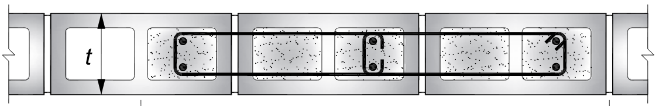
Pilasters for Opening Support
Types
Projecting
Treat wall as flange if comply with TMS 402 5.1.1.2.1 and 5.1.1.2.5.
Flange width per TMS 5.1.1.2.3.
Flush
Ties only required if:
Longitudinal bars used to resist compression
Then meet column requirements
Figures from RMEH
Out-of-Plane Behavior and Design
4/12/2022
65

Slide 66
Pilasters for Opening Support
Longitudinal reinforcement
No minimum quantity
ρ_{max}
Figures from RMEH
Out-of-Plane Behavior and Design
4/12/2022
66

Slide 67
Agenda
Behavior
Code Requirements
Reinforcing Congestion Limits
Pilasters
P-Delta (Strength Design)

Slide 68
P-Delta for Strength Design
If you are design the wall using the strength design provisions, the design of the jamb regions, or pilasters used as jambs, must consider P-Delta effects per TMS 402 Section 9.3.5.
Out-of-Plane Behavior and Design
4/12/2022
68

Slide 69
In-Plane Vertical Behavior and Design
Beams and lintels

Slide 70
Agenda
Behavior
Arching
Beams
Strut and Tie (Deep Beam)
Code Requirements
Span Length
Deflection

Slide 71
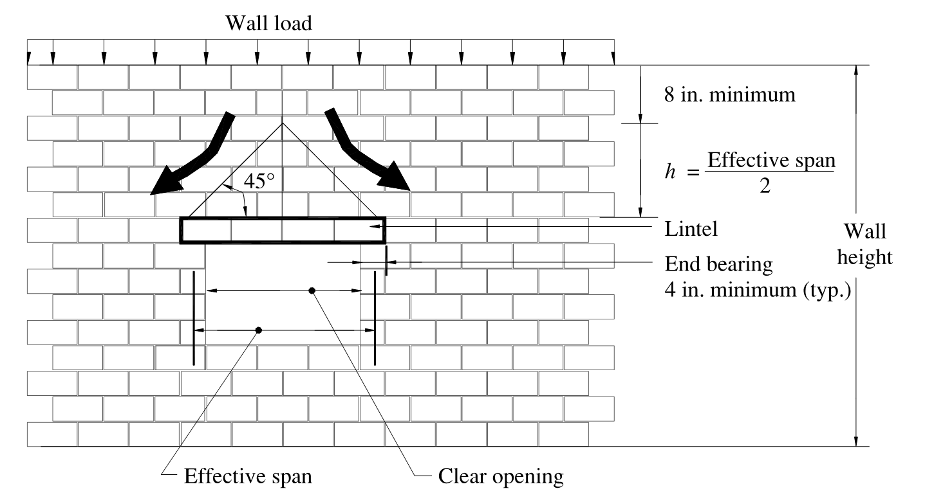
In-Plane Vertical Behavior - Arching
Figures NCMA :Lintel Design Manual (2004)
In-Plane Vertical Behavior and Design
4/12/2022
71

Slide 72
In-Plane Vertical Behavior - Arching
Per NCMA Lintel Design Manual the following criteria should be met:
Masonry wall is laid in running bond
Sufficient wall height above the lintel to form a 45 degree triangle
Wall height above the arch height is at least 8 inches
Minimum end bearing is maintained
There is sufficient masonry on either side of the opening to resist the induced horizontal thrust
control joints or other discontinuities are not located adjacent to the opening
In-Plane Vertical Behavior and Design
4/12/2022
72

Slide 73
In-Plane Vertical Behavior - Arching
Mechanics are sound, but . . .
Not explicitly code compliant
“Sufficient masonry on either side of the opening to resist the induced horizontal thrust” . . . How do we quantify that?
Is it necessary?
In-Plane Vertical Behavior and Design
4/12/2022
73

Slide 74
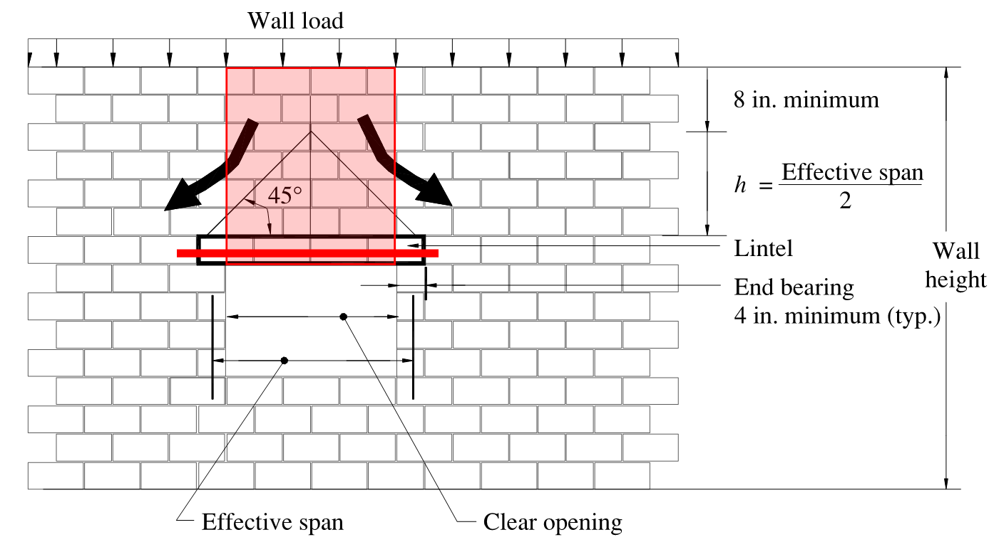
In-Plane Vertical Behavior - Arching
Figures NCMA :Lintel Design Manual (2004)
In-Plane Vertical Behavior and Design
4/12/2022
74

Slide 75
In-Plane Vertical Behavior - Beam
Member is relatively shallow with respect to span.
Behavior dominated by flexure
Plane sections remain plane.
In-Plane Vertical Behavior and Design
4/12/2022
75

Slide 76
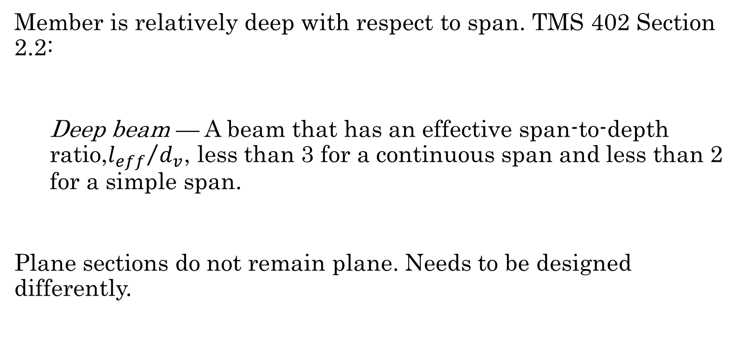
In-Plane Vertical Behavior – Deep Beam
Member is relatively deep with respect to span. TMS 402 Section 2.2:
Deep beam — A beam that has an effective span-to-depth ratio,${l_{eff}}/{d_{v}}$, less than 3 for a continuous span and less than 2 for a simple span.
Plane sections do not remain plane. Needs to be designed differently.
In-Plane Vertical Behavior and Design
4/12/2022
76

Slide 77
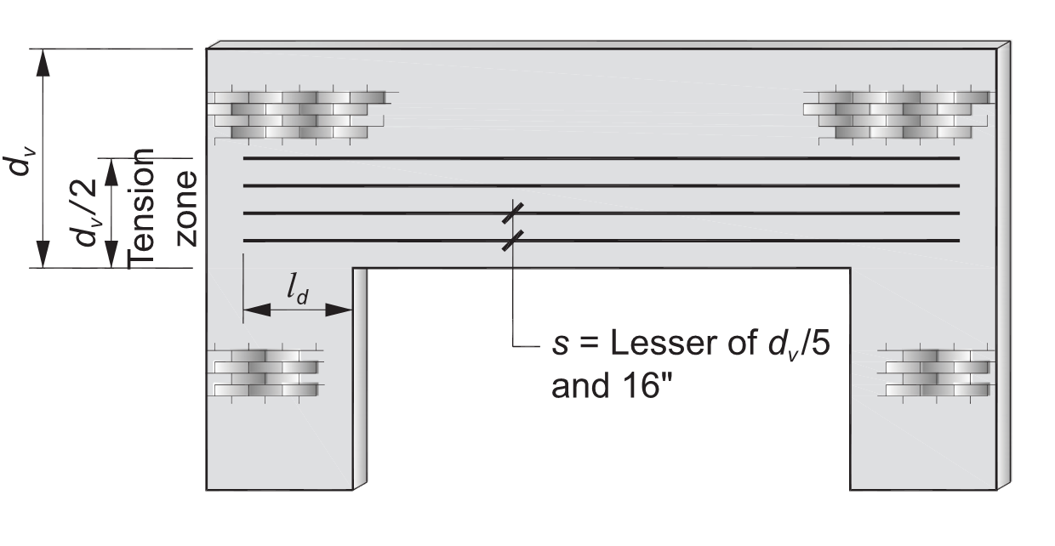
In-Plane Vertical Behavior – Deep Beam
Figure from the RMEH
In-Plane Vertical Behavior and Design
4/12/2022
77

Slide 78
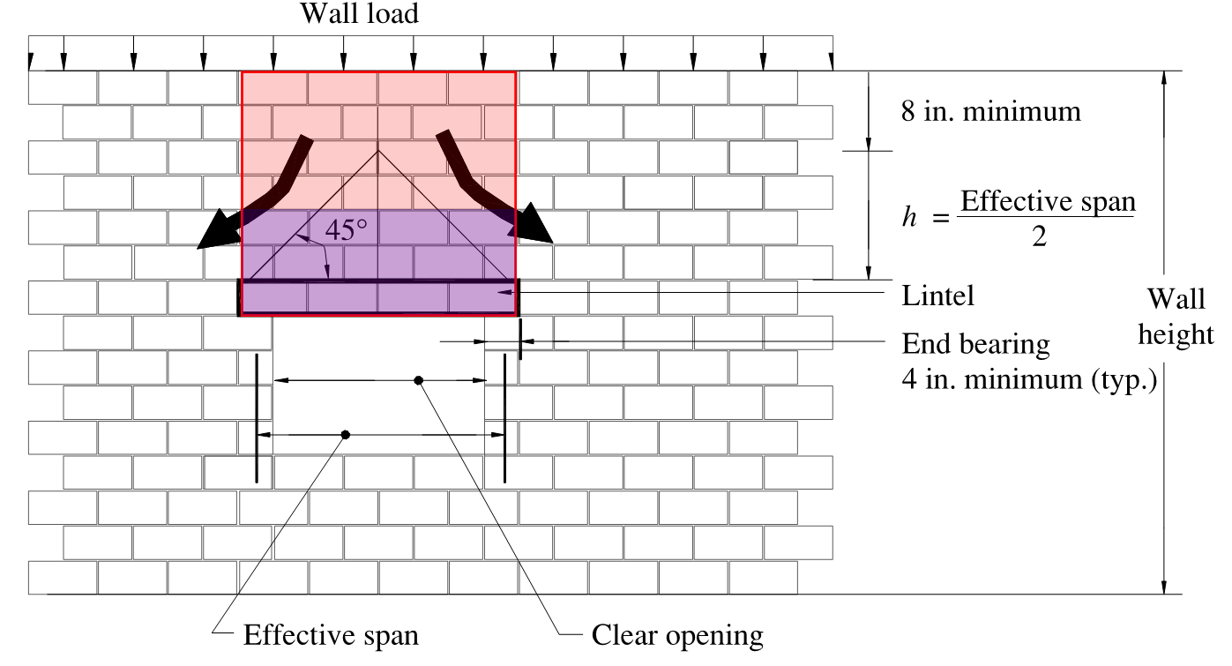
In-Plane Vertical Behavior – Deep Beam
Commentary to TMS 402 Section 5.2.2
In-Plane Vertical Behavior and Design
4/12/2022
78

Slide 79
Agenda
Behavior
Arching
Beams
Strut and Tie (Deep Beam)
Code Requirements
Span Length
Deflection

Slide 80
In-Plane Vertical Behavior – Span
5.2.1.1 Span length — Span length shall be in accordance with the following:
5.2.1.1.1 Span length of beams not built integrally with supports shall be taken as the clear span plus depth of beam, but need not exceed the distance between centers of supports.
5.2.1.1.2 For determination of moments in beams that are continuous over supports, span length shall be taken as the distance between centers of supports.
What about other cases?
In-Plane Vertical Behavior and Design
4/12/2022
80

Slide 81
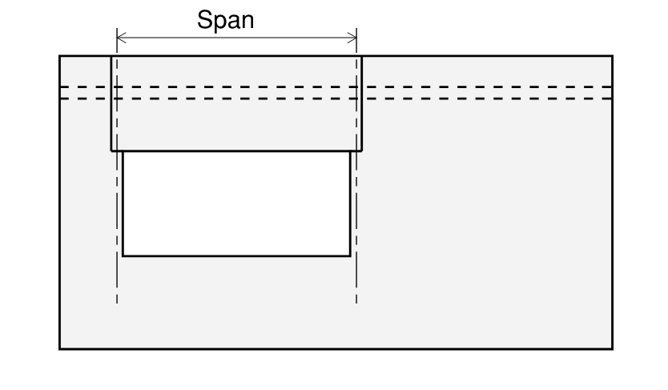
In-Plane Vertical Behavior – Span
In-Plane Vertical Behavior and Design
4/12/2022
81

Slide 82
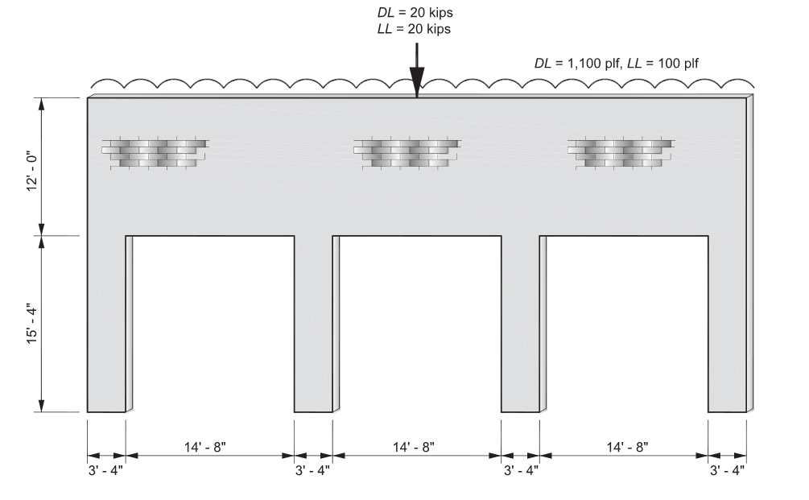
In-Plane Vertical Behavior – Span
In-Plane Vertical Behavior and Design
4/12/2022
82

Slide 83
In-Plane Vertical Behavior – Span
TMS 402-16 Preview
5.3.1.1 Span length — Minimum span length shall be the distance from face-to-face of supports, plus ½ of the required bearing length at each end.
In-Plane Vertical Behavior and Design
4/12/2022
83

Slide 84
In-Plane Vertical Behavior – Deflection
5.2.1.4 Deflections — Masonry beams shall be designed to have adequate stiffness to limit deflections that adversely affect strength or serviceability.
5.2.1.4.1 The calculated deflection of beams providing vertical support to masonry designed in accordance with Section 8.2, Section 9.2, Section 11.2, Chapter 14, or Appendix A shall not exceed l/600 under allowable stress level dead plus live loads.
Note: 5.2.1.4.1 applies to unreinforced masonry only.
In-Plane Vertical Behavior and Design
4/12/2022
84

Slide 85
In-Plane Vertical Behavior – Deflection
Caveats:
Cracking – make sure to consider when required
Creep – From commentary – “This deflection limit is for immediate deflections. Creep will cause additional long-term deflections. A larger deflection limit of l/480 has been used when considering long-term deflections.”
Creep coefficients given in TMS 402 Section 4.2.6 yield much smaller deflection increases than for concrete beams in ACI 318.
In-Plane Vertical Behavior and Design
4/12/2022
85

Slide 86
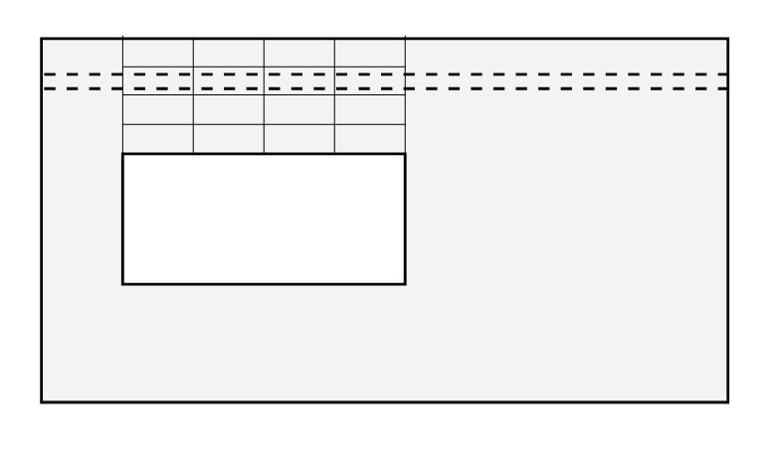
Stack Bond Lintel
Important to not just have head joints to transfer shear.
At least 50% of the cross section should be continuous grout filled.
Out-of-Plane Behavior and Design
4/12/2022
86

Slide 87
In-Plane Lateral Behavior and Design
Seeking clarity

Slide 88
Agenda
Behavior
Elastic
Inelastic
Code Requirements
Conventional Design TMS Chapters 7, 8 and 9
ASCE 7 Chapter 14 (Not mandated!)
Appendix C – Limit Design
Proposed Approach to Conventional Design

Slide 89
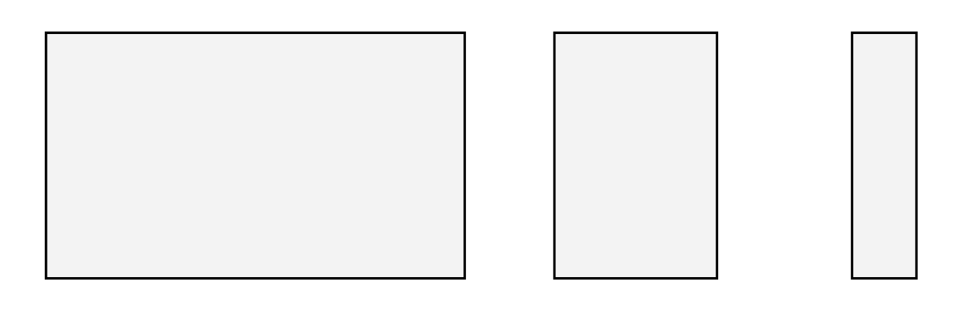
In-Plane Behavior – Elastic
What is behavior of simple cantilever walls under elastic conditions?
In-Plane Lateral Behavior
4/12/2022
89

Slide 90
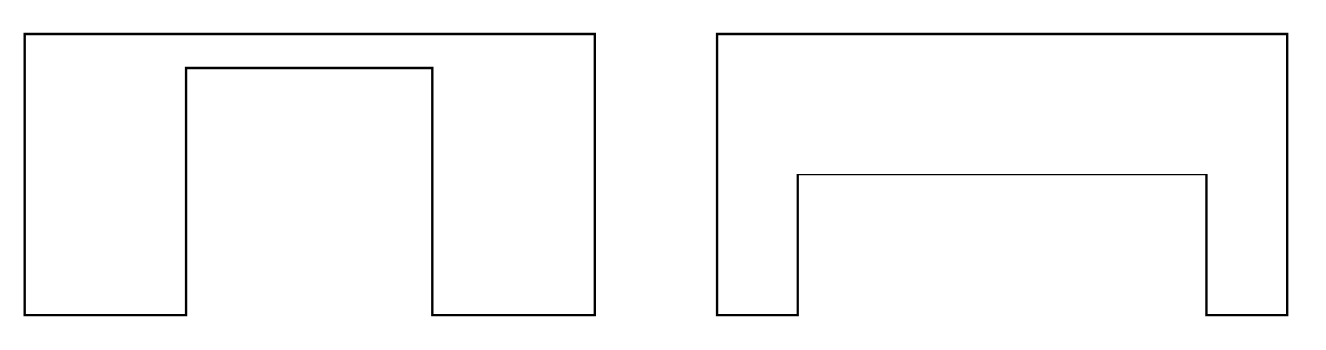
In-Plane Behavior – Elastic
What about a wall with an opening?
How will piers behave? Beam?
In-Plane Lateral Behavior
4/12/2022
90

Slide 91
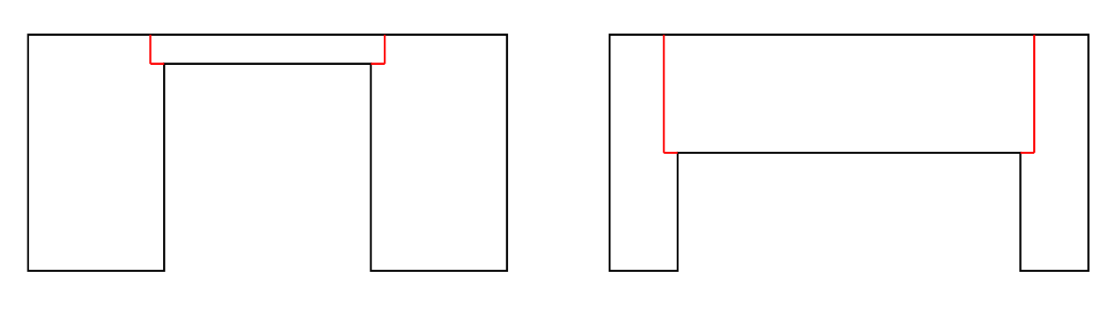
In-Plane Behavior – Elastic
And if we put joints in?
In-Plane Lateral Behavior
4/12/2022
91

Slide 92
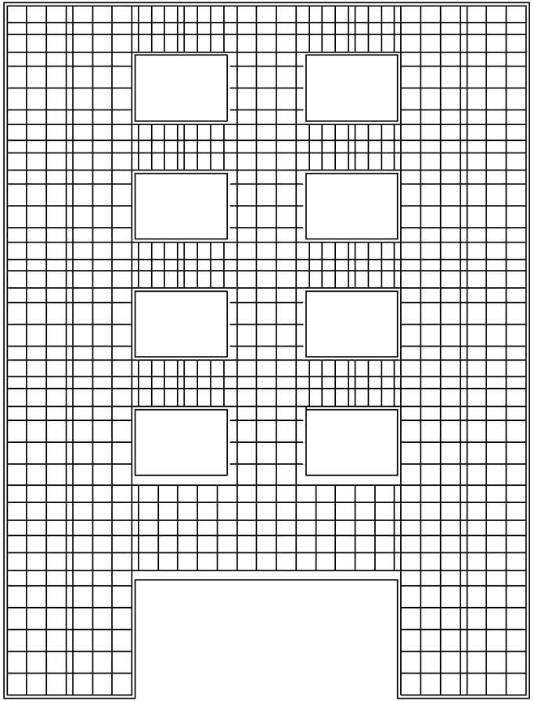
In-Plane Behavior – Elastic
What about a multistory wall with openings?
In-Plane Lateral Behavior
4/12/2022
92

Slide 93
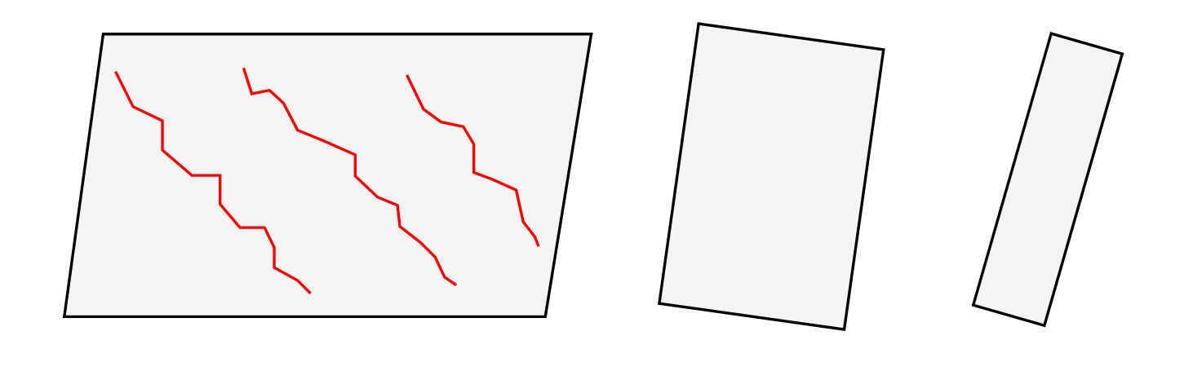
In-Plane Behavior – Inelastic
What limit states should we consider?
What do we think about the behavior of those limit states?
In-Plane Lateral Behavior
4/12/2022
93

Slide 94
In-Plane Behavior – Inelastic
What limit states should we consider?
In-Plane Lateral Behavior
4/12/2022
94

Slide 95
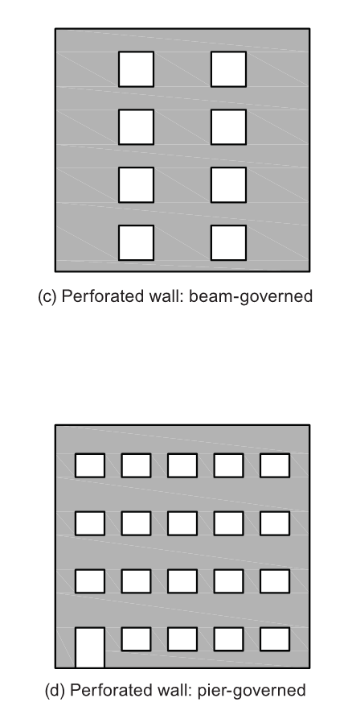
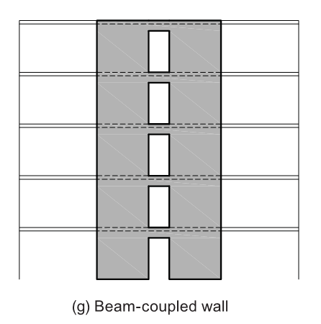
In-Plane Behavior – Inelastic
Figures from NEHRP Seismic Design Technical Brief No. 9
What about these walls?
Note: Perforated versus coupled walls
What additional limit state may be of concern?
In-Plane Lateral Behavior
4/12/2022
95

Slide 96
Agenda
Behavior
Elastic
Inelastic
Code Requirements
Conventional Design TMS Chapters 7, 8 and 9
ASCE 7 Chapter 14 (Not mandated!)
Appendix C – Limit Design
Proposed Approach to Conventional Design

Slide 97
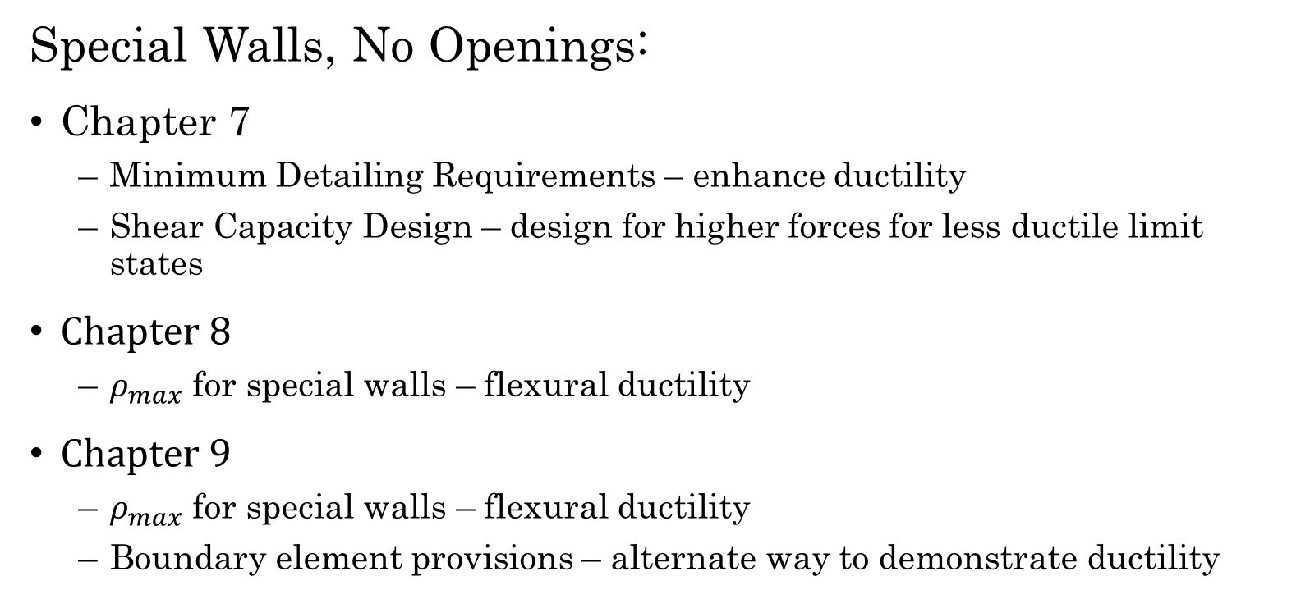
In-Plane Wall Design – TMS 402
Special Walls, No Openings:
Chapter 7
Minimum Detailing Requirements – enhance ductility
Shear Capacity Design – design for higher forces for less ductile limit states
Chapter 8
$ρ_{max}$ for special walls – flexural ductility
Chapter 9
$ρ_{max}$ for special walls – flexural ductility
Boundary element provisions – alternate way to demonstrate ductility
In-Plane Lateral Design
4/12/2022
97

Slide 98
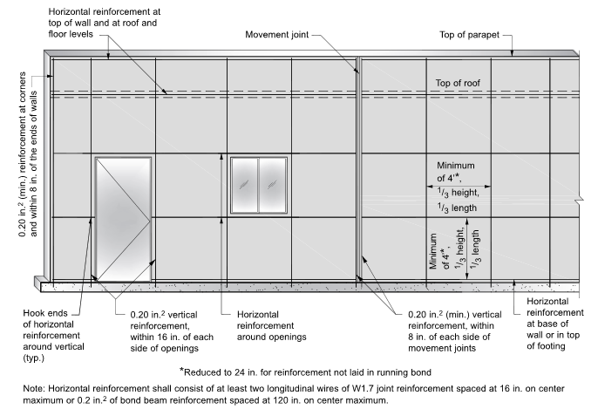
In-Plane Wall Design - TMS 402
In-Plane Lateral Design
4/12/2022
98

Slide 99
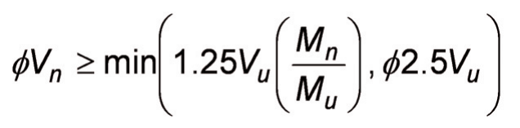
In-Plane Wall Design - TMS 402
Special Walls – Shear Capacity Design (TMS 7.3.2.6.1.1)
Either:
V_{n} must equal or exceed 2.5V_{u}, or
φV_{n} must equal or exceed the shear associated with the wall reaching 1.25 times its nominal yield strength.
In-Plane Lateral Design
4/12/2022
99
Notes:
There is a subtlety to this provision that it is sometimes missed, which is the that 2.5 Vu requirement is applied to Vn, whereas the flexural based requirement is applied to phi Vn.

Slide 100
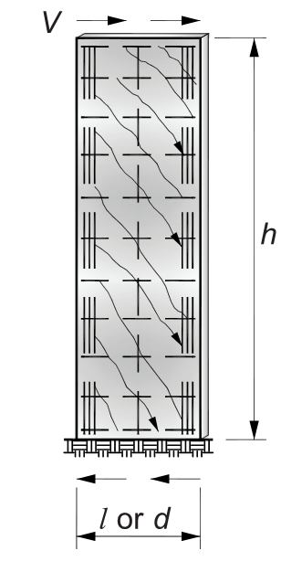
In-Plane Wall Design - TMS 402
Special Walls – TMS 7.3.2.6.1.1 Shear Capacity Design
Intent is to achieve flexural behavior or ensure that the wall remains essentially elastic
Note that M_{n} must consider all reinforcing that will contribute to flexural strength
Shortcut – Use 2.5V_{u} to avoid computing an exact M_{n}
In-Plane Lateral Design
4/12/2022
100

Slide 101

In-Plane Wall Design – TMS 402
Observations on Limit States:
TMS 402-16 takes steps to address shear and flexure limit states
Displacement limit state:
Optional Boundary Zone check in lieu of $ρ_{max}$
But that is limited to cantilever walls
Story mechanism not addressed
Really only cantilevered walls considered
In-Plane Lateral Design
4/12/2022
101

Slide 102

In-Plane Wall Design – ASCE 7
Observations on Limit States:
ASCE 7
Displacement limits, Table 12.12.1
Masonry cantilever shear wall structures = 0.010 h_{sx}
Other masonry shear wall structures = 0.007 h_{sx}
Is this sufficient to address concentration of displacements?
Vertical Irregularities
Weak Story <80% of story above
Extreme Weak Story <80% of story above
Are these sufficient to prevent a weak story?
In-Plane Lateral Design
4/12/2022
102

Slide 103
In-Plane Wall Design – Code
NEHRP Design Guide 9:
Argues that shear capacity provisions may not be sufficient to prevent concentration of shear damage in a single story.
Recommends designing for R = 1.5 in these situations.
Not just a masonry issue
ACE 318-19 does have large increases in shear amplification . . .
In-Plane Lateral Design
4/12/2022
103

Slide 104
Agenda
Behavior
Elastic
Inelastic
Code Requirements
Conventional Design TMS Chapters 7, 8 and 9
ASCE 7 Chapter 14 (Not mandated!)
Appendix C – Limit Design
Proposed Approach to Conventional Design

Slide 105
In-Plane Wall Design – ASCE 7
ASCE 7 Chapter 14 is not adopted by the IBC, so this is not mandatory.
Has a provision that would modify TMS 402 to add a coupling beam provision.
Unclear what the intent is relative to perforated walls.
Would it be necessary to apply to all horizontal wall elements?
How would this work in ASD?
Should we get a better R value if we do this?
In-Plane Lateral Design
4/12/2022
105

Slide 106
In-Plane Wall Design – ASCE 7
9.3.4.2.5 Coupling Beams. Structural members that provide coupling between shear walls shall be designed to reach their moment or shear nominal strength before either shear wall reaches its moment or shear nominal strength. Analysis of coupled shear walls shall comply with accepted principles of mechanics.
The design shear strength, ɸV_{n}, of the coupling beams shall satisfy the following criterion:
ɸV_{n} ≥ 1.25(M₁+M₂)/L_{c} + 1.4V_{g}
In-Plane Lateral Design
4/12/2022
106

Slide 107
In-Plane Wall Design – ASCE 7
M₁, M₂ = Nominal moment strength at the ends of the beam;
L_{c} = Length of the beam between the shear walls; and
V_{g} = Unfactored shear force caused by gravity loads.
The calculation of the nominal flexural moment shall include the reinforcement in reinforced concrete roof and floor systems. The width of the reinforced concrete used for calculations of reinforcement shall be six times the floor or roof slab thickness.
In-Plane Lateral Design
4/12/2022
107

Slide 108

In-Plane Wall Design – ASCE 7
Essentially same requirement as ACI 318 for special moment frame beam. See excerpt from Figure R18.6.5.
In-Plane Lateral Design
4/12/2022
108

Slide 109
Agenda
Behavior
Elastic
Inelastic
Code Requirements
Conventional Design TMS Chapters 7, 8 and 9
ASCE 7 Chapter 14 (Not mandated!)
Appendix C – Limit Design
Proposed Approach to Conventional Design

Slide 110





A Method for the Seismic Design of Perforated Special Masonry Shear Walls
Limit Design
4/12/2022
110
Notes:
The two key requirements for the use of this method are that the wall design is governed by seismic demands and that the wall is perforated.
This method is only applicable to seismic design because it relies on non-linear behavior of the wall which is only acceptable under code level seismic loads
If you have walls that meet these requirements, it may be worthwhile to consider this method as it generally allows lighter, more uniform reinforcing.

Slide 111
How is Limit Design Different?
Considers the strength of the wall as a system
Explicitly considers how hinging of piers and spandrels could lead to a collapse mechanism
Considers both the strength of the system and its capacity to deform.
Limit Design
4/12/2022
111
Notes:
In conventional design a perforated wall is designed by looking at the strength of each pier or spandrel independently; limit design looks at the strength of the perforated wall as a whole
It does this by explicitly considering the mechanism that would have to form before collapse – a mechanism created by hinging of the piers and spandrels
The method considers both the strength of the wall and its deformation capacity – the wall must be able to deform far enough to allow the mechanism to be developed.

Slide 112

How is Limit Design Different?
Conventional Design
Limit Design
Limit Design
4/12/2022
112
Notes:
In conventional design a perforated wall is designed by looking at the strength of the each pier or spandrel independently based on forces from an elastic analysis; limit design looks at the strength of the perforated wall as a whole
As a result, in a conventional design some of the components are working hard – the demand is nearly equal to the capacity – while other components have excess capacity due to minimum prescriptive reinforcing.
In a limit design, all of the components are fully mobilized and contributing to the capacity of the wall.

Slide 113

When to Use Limit Design?
Must Have:
Wall with openings
Walls governed by seismic loads
Special reinforced masonry walls
Axial loads $≤0.3 f_{m}^{′}A_{g}$(TMS C3.3)
Limit Design
4/12/2022
113
Notes:
The wall must be perforated so that a mechanism with multiple hinges occurs. If there are no perforations, the wall will hinge at the base only and there is no advantage to the limit design method.
Limit design assumes nonlinear behavior. As such it is only appropriate for code level seismic loads
The walls must be detailed as special walls to have sufficient reinforcing to so that there is enough ductility for hinges to occur.
Because of concern about the performance of hinges with high axial loads, there is a limit on how much axial load can be in the wall.

Slide 114
Why Use Limit Design?
Project Benefits:
Uniform reinforcing
Less reinforcing
Use masonry facades as structural elements
Limit Design
4/12/2022
114
Notes:
Limit design allows the use of uniform reinforcing throughout the height of the wall. This may result in a more constructible, less congested wall.
Trial design studies indicated that there are some savings of reinforcing, on the order of 10 to 30%.
This method allows perforated facades, which are usually thought of as non-structural elements, to be designed as structural elements – could be potential savings to the project.

Slide 115
Why Use Limit Design?
Engineering Benefits:
Clarity on system behavior
Coupling beam design
Ability to allow components to hinge
Limit Design
4/12/2022
115
Notes:
There are also benefits to the designer of using limit design:
The behavior of the system at the limit condition is clear and can be the conscious choice of the designer, rather than the outcome of a design for forces from an elastic analysis.
TMS 402 does not otherwise provide guidance on the design of coupled walls.
Rather than concentrating reinforcing at certain locations, the designer can choose to allow a hinge to form instead.

Slide 116
How to Use Limit Design
Conventional:
Limit States:
Determine base shear
Determine base shear
Distribute base shear to wall lines
Distribute base shear to wall lines
Assume wall reinforcing
Determine demands on wall components
Determine controlling mechanism
Design reinforcing for component demands
Check mechanism strength
Check mechanism deformations
Limit Design
4/12/2022
116

Slide 117
Virtual Work
Work = Force x Displacement
P x Δ
M x θ
External Work and Internal Work must be in equilibrium
Limit Design
4/12/2022
117

Slide 118
Virtual Work
Internal Work: Internal plastic hinges undergoing rotations.
=
External Work: External force moving with building.
Limit Design
4/12/2022
118

Slide 119




Virtual Work
Cantilever Wall
Statics:
Δ
V_{u}
$$V_{u}h=φM_{n}$$
Virtual Work:
External Work:
Internal Work:
h
$$V_{u}Δ$$
φM_{n}
$$φM_{n}θ$$
θ
$$V_{u}Δ=φM_{n}θ$$
Limit Design
4/12/2022
119

Slide 120




Virtual Work
Cantilever Wall
Δ
V_{u}
$$V_{u}Δ=φM_{n}θ$$
$$θ=\frac{Δ}{h}$$
h
$$V_{u}Δ=\frac{φM_{n}Δ }{h}$$
φM_{n}
$$V_{u}h=φM_{n}$$
θ
Limit Design
4/12/2022
120

Slide 121




Virtual Work
Coupled Wall – Pinned Base
Δ
V_{u}
φM_{n}
φM_{n}
θ_{b}
h
θ
$$P_{u}$$
$$l$$
$$P_{u}$$
$$L$$
Limit Design
4/12/2022
121

Slide 122




Virtual Work
Coupled Wall – Pinned Base
Statics:
Δ
V_{u}
φM_{n}
$$P_{u}=\frac{V_{u}h }{L}$$
φM_{n}
θ_{b}
h
$$M_{u,beam}=\frac{P_{u}l }{2}=V_{u}h\frac{l}{2L}$$
θ
$$P_{u}$$
$$l$$
$$P_{u}$$
$$L$$
$$φM_{n}≥V_{u}h\frac{l}{2L}$$
Limit Design
4/12/2022
122

Slide 123



Virtual Work
Coupled Wall – Pinned Base
Virtual Work:
External Work:
Internal Work:
Δ
V_{u}
φM_{n}
φM_{n}
$$V_{u}Δ$$
θ_{b}
h
$${2φM}_{n}θ_{b}$$
θ
$$P_{u}$$
$$l$$
$$P_{u}$$
$$V_{u}Δ{=2φM}_{n}θ_{b}$$
$$L$$
Limit Design
4/12/2022
123

Slide 124




Virtual Work
Coupled Wall – Pinned Base
$$V_{u}Δ{=2φM}_{n}θ_{b}$$
Δ
V_{u}
φM_{n}
$$θ=\frac{Δ}{h}$$
φM_{n}
θ_{b}
h
$$θ_{b}=θ\frac{L}{l}$$
θ
$$P_{u}$$
$$l$$
$$P_{u}$$
$$θ_{b}=\frac{Δ}{h}\frac{L}{l}$$
$$L$$
Limit Design
4/12/2022
124
Limit Design
4/12/2022
124

Slide 125


Virtual Work
Coupled Wall – Pinned Base
$$V_{u}Δ{=2φM}_{n}θ_{b}$$
Δ
V_{u}
φM_{n}
φM_{n}
$$V_{u}Δ{=2φM}_{n}\frac{Δ}{h}\frac{L}{l}$$
θ_{b}
h
$$φM_{n}≥V_{u}h\frac{l}{2L}$$
θ
$$P_{u}$$
$$l$$
$$P_{u}$$
$$L$$
Limit Design
4/12/2022
125

Slide 126


Provisions
Limit Design
4/12/2022
126
Notes:
The two key requirements for the use of this method are that the wall design is governed by seismic demands and that the wall is perforated.
This method is only applicable to seismic design because it relies on non-linear behavior of the wall which is only acceptable under code level seismic loads
If you have walls that meet these requirements, it may be worthwhile to consider this method as it generally allows lighter, more uniform reinforcing.

Slide 127
Appendix C Provisions
C. General — The limit design method shall be permitted to be applied to a line of lateral load resistance consisting of fully grouted special reinforced masonry shear walls that are designed per the strength design provisions of Chapter 9, except that the provisions of Section 9.3.3.2 and Section 9.3.6.6 shall not apply.
ρ_{max}
Boundary zones
Limit Design
4/12/2022
127

Slide 128
Appendix C Provisions
C.1 Yield mechanism — It shall be permitted to use limit analysis to determine the controlling yield mechanism and its corresponding base-shear strength, V_{lim} , for a line of lateral load resistance, provided that (a) through (e) are satisfied:
Limit Design
4/12/2022
128

Slide 129
Appendix C Provisions
(a) The relative magnitude of lateral seismic forces applied at each floor level shall correspond to the loading condition producing the maximum base shear at the line of resistance in accordance with analytical procedures permitted in Section 12.6 of ASCE 7.
V_{base}
Limit Design
4/12/2022
129

Slide 130
Appendix C Provisions
(b) In the investigation of potential yield mechanisms induced by seismic loading, plastic hinges shall be considered to form at the faces of joints and at the interfaces between masonry components and the foundation.
Concept: If hinge length considered, rotations would increase. Higher rotation = higher internal work.
Limit Design
4/12/2022
130

Slide 131



Appendix C Provisions
Upward vertical earthquake
(c) The axial forces associated with Load Combination 7 of Section 2.3.6 of ASCE 7 shall be used when determining the strength of plastic hinges, except that axial loads due to horizontal seismic forces shall be permitted to be neglected.
Concept: Mechanism capacity unaffected. Axial load strengthens one hinge, weakens other
$$P_{u}$$
$$P_{u}$$
Limit Design
4/12/2022
131

Slide 132

Appendix C Provisions
(d) The strength assigned to plastic hinges shall be based on the nominal flexural strength, M_{n} , but shall not exceed the moment associated with one-half of the nominal shear strength, V_{n} , calculated using Section 9.3.4.1.2.
Member in double curvature:
$$M_{n}≤\frac{V_{n}}{2}\frac{l}{2}=\frac{V_{n}l}{4}$$
Goal: Behavior dominated by flexure
Limit Design
4/12/2022
132

Slide 133
Appendix C Provisions
(e) At locations other than the plastic hinges identified in C.1(b), moments shall not exceed the strengths assigned in C.1(d) using the assumptions of C.1(c).
Goal: Behavior outside of hinge locations remains elastic
Limit Design
4/12/2022
133

Slide 134

Appendix C Provisions
C.2 Mechanism strength — The yield mechanism associated with the limiting base-shear strength, V_{lim} , shall satisfy the following:
$${φV}_{lim}≥V_{ub}$$
The value of φ assigned to the mechanism strength shall be taken as 0.8. The base-shear demand, V_{ub} , shall be determined from analytical procedures permitted in Section 12.6 of ASCE 7.
Limit Design
4/12/2022
134

Slide 135
Appendix C Provisions
C.3 Mechanism deformation — The rotational deformation demand on plastic hinges shall be determined by imposing the design displacement, C_{d}δ_{ne} , at the roof level of the yield mechanism. The rotational deformation capacity of plastic hinges shall satisfy C.3.1 to C.3.3.
In TMS 402-22 this will likely be increased to MCE_{R} level displacement, 1.5C_{d}δ_{ne}
Limit Design
4/12/2022
135

Slide 136

Appendix C Provisions
C.3.1 The rotational deformation capacity of plastic hinges shall be taken as 0.5 l_{w} ε_{mu} / c . The value of c shall be calculated for the P_{u} corresponding to Load Combination 6 of Section 2.3.6 of ASCE 7.
0.5l_{w} = assumed hinge length
$\frac{ε_{mu}}{c}$ = maximum curvature
$ε_{mu}$ = maximum strain permitted in masonry
c = distance to neutral axis (function of reinforcing and axial load)
Limit Design
4/12/2022
136

Slide 137

Appendix C Provisions
$$c=\frac{A_{s}f_{y}+P_{u}}{0.64{f′}_{m}t}$$
Limit Design
4/12/2022
137

Slide 138

Appendix C Provisions
C.3.2 The angular deformation capacity of masonry components whose plastic hinge strengths are limited by shear as specified in C.1(d), shall be taken as 1 / 400. The angular deformation capacity shall be permitted to be taken as 1 / 200 for masonry components satisfying the following requirements:
$$M_{n}≤\frac{V_{n}l}{4}$$
Concept: Deformation capacity should be reduced if shear may influence behavior

Slide 139
Appendix C Provisions
“Shear Package”
(a) The areas of transverse and longitudinal reinforcement shall each not be less than 0.001 multiplied by the gross cross-sectional area of the component, using specified dimensions;
(b) Spacing of transverse and longitudinal reinforcement shall not exceed the smallest of 24 in., l_{w} / 3 , and h_{w} / 3.
(c) Reinforcement ending at a free edge of masonry shall be anchored around perpendicular reinforcing bars with a standard hook.
Limit Design
4/12/2022
139

Slide 140

Examples
Limit Design
4/12/2022
140
Notes:
The two key requirements for the use of this method are that the wall design is governed by seismic demands and that the wall is perforated.
This method is only applicable to seismic design because it relies on non-linear behavior of the wall which is only acceptable under code level seismic loads
If you have walls that meet these requirements, it may be worthwhile to consider this method as it generally allows lighter, more uniform reinforcing.

Slide 141
Example 1:
Limit Design
4/12/2022
141
Notes:
This process is best illustrated with an example.
We have chosen a one-story example for simplicity. These concepts can also be applied to multi-story walls. We will have a couple slides at the close to illustrate that.

Slide 142
Example 1
Single-story automobile repair facility with:
Gravity System: Steel roof trusses spanning to load-bearing CMU walls.
Design Elevation: Front entry to the building – an eight inch, reinforced CMU wall that acts as a component of the seismic system for the building.
Limit Design
4/12/2022
142

Slide 143

Example 1
Seismic Design Criteria:
TMS 402-16; Special Reinforced Masonry Shear Wall.
ASCE 7 Criteria; R-Value = 5.0, $C_{d}= 3.5$
Line of Resistance Demands;
$VU=37.5k$;
$δe=.11 in$;
$δeCd = .40 in$ (0.2%)
Limit Design
4/12/2022
143
Notes:
The first two steps are the same as for conventional design – the base shear on the structure is determined, and the an analysis is performed to distribute the base shear to lines of resistance.
For this wall, it was determined that the wall would need to resist a load of 37.5 kips and would have an inelastic displacement of 0.4 inches.

Slide 144
Example 1 1) ASCE 7 Analysis
A
B
C
Limit Design
4/12/2022
144
Notes:
While the analysis may produce a lot of data, we are really interested in just three load combinations.
<click to bring in image>
Note that the first is intended to produce the smallest axial load, which will give the smallest hinge strengths for estimating the mechanism strength. Note that subscript “v” on the earthquake loads, means that we are only considering vertical earthquake effects. The reason for this is that the net axial load from the horizontal earthquake effect is zero – while some hinges may have smaller axial loads and hinge capacities those capacities will be balanced by other hinges which will have larger axial loads and hinge capacities. As far as the mechanism as a whole, the net effect is zero.
The other two load combinations are intended to produce the maximum axial loads, which will give the smallest deformation capacities for the hinges.

Slide 145
Limit Design: Example 2) Select Reinforcement
A
B
C
Limit Design
4/12/2022
145
Notes:
In order to use the limit design method, it is necessary to assume reinforcing in the wall. While this may seem daunting, the simplest answer is that these walls want to be lightly reinforced, so a good starting point is to determine the reinforcing required for out-of-plane loads and the minimum prescriptive reinforcing requirements for a special reinforced masonry shear wall.
Note pier B horizontal reinforcing is governed by spacing requirements.

Slide 146

Limit Design: Example 3) Determine Mechanism
Virtual Work:
Internal Work: Internal plastic hinges undergoing rotations.
=
External Work: External force moving with building.
Limit Design
4/12/2022
146
Notes:
Only really one possible mechanism given proportions of piers to solid wall above. We’ll show some examples of more complicated mechanisms later.
Since this is a one-story structure, a pier hinging mechanism is acceptable as it would not be considered to be a weak story.
Virtual work is simply the idea that work done by the external forces must be resisted by an equal amount work within the structure.
Work = force over distance.
External work is equal to the externally applied seismic load times the displacement of the structure
Internal work is equal to the moment capacity of the hinges times the rotation of the hinge.
The capacity of the mechanism is adequate if the internal work that can be performed by the mechanism in excess of the external work that would be done by code required lateral load on the wall over the displacem

Slide 147
Limit Design: Example 3) Determine Mechanism – Internal Work
Note minimum axial load
Determine hinge capacity
A
Note use φ = 1.0
Limit Design
4/12/2022
147
Notes:
In order to determine the internal work, it is necessary to determine the moment capacity of the hinge for the minimum axial load that the hinge will experience. An interaction diagram is one way to do this. Note that πηι = 1.0 for this interaction diagram, because πηι is applied at the system level for limit design.
This is done for each unique hinging component in the structure.

Slide 148

Limit Design: Example 3) Determine Mechanism – Internal Work
Δ_{M}
Determine hinge rotation
h_{p}
A
Hinge Rotation – Pier A
$$θ=\frac{Δ_{M}}{h_{p}}=\frac{0.4in}{(10ft)(12in/ft)}=0.0033$$
Limit Design
4/12/2022
148
Notes:
The hinge rotation is determined by imposing a displacement on the mechanism. This movement can be any convenient value. In this example, we have used Delta M because we will need to determine the rotation due to Delta M when we check the deformation capacity of the hinges. Using Delta M here is a small time saver.
Note that rotation of Pier A will be less than the shorter piers to the right, as all the top of all the piers are displacing Delta M.

Slide 149

Limit Design: Example 3) Determine Mechanism – Internal Work
$$IW_{A}=\sum{M_{n,A}θ=(2)(97)(12)(0.0033)=7.68k−in}$$
Internal Work Done By Pier B:
$$IW_{B}=\sum{M_{n,B}θ=(2)(33)(12)(0.0042)=3.33k−in}$$
Internal Work Done By Pier C:
$$IW_{C}=\sum{M_{n,C}θ=(2)(96)(12)(0.0042)=9.68k−in}$$
Total Internal Work:
$$\sum{M_{n}θ=7.68+3.33+9.68=20.7k\text{−}in}$$
Limit Design
4/12/2022
149
Notes:
With the capacities and rotations of the hinges known, the internal work can be determined.
Starting with Pier A, there are two hinges – one top and one bottom – with a capacity of 97 k-ft and a rotation of 0.0033, resulting in Pier A performing 7.68 k-in of work.
Similarly, the work for Piers B and C can be computed.
The work done by all three piers can then be summed to determine the total internal work performed by the mechansim.

Slide 150




Limit Design: Example 3) Determine Mechanism – External Work
$$∆M= 0.40”$$
External Work = Internal Work
$$V’lim∆M = 20.7 k\text{−}in$$
Therefore
$$V’lim⁡$$
$${V′}_{lim}=\frac{20.7}{0.4}=51.8 kips$$
Limit Design
4/12/2022
150
Notes:
Since external work that the mechanism can perform is equal to the internal work, we can determine the capacity of the mechanism by dividing the internal work by the assumed displacement.
Note that this not quite the capacity of the mechanism – we need to check whether any of the hinges need to have their capacity reduced due to the shear demand on the component being greater than 50% of the shear capacity.

Slide 151
Limit Design: Example 3) Determine Mechanism – Capacity
$$∅{V′}_{lim}=0.8\left(51.8\right)=41.4k> V_{ub}=37.5k$$
Limit Design
4/12/2022
151
Notes:
But before we go on to check whether we have any shear limited hinges, it is prudent to apply the 0.8 phi factor for limit mechanisms to this value to the unreduced mechanism capacity before we proceed.
Close! Hopefully we don’t have any shear controlled hinges!

Slide 152



Limit Design: Example 3) Determine Mechanism – Shear-controlled capacity
Shear-influenced Elements (C.1(d))
$$V_{n}<2{V′}_{u}$$
Note: If
Limit Design Method not permitted
n
n
$$V_{n}<{V′}_{u}$$
M_{n1}
u
n
n
Limit Design
4/12/2022
152
Notes:
While the mechanism capacity appears to be adequate, this assumes strongly flexural behavior – if shear behavior becomes important, the mechanism may not be able to achieve the predicted capacity.
In the limit design procedure, shear behavior must be considered when the shear capacity of an element is less than twice the shear associated with plastic hinging.
When this occurs, the both the flexural and deformation capacity of the hinges is reduced.

Slide 153




Limit Design: Example 3) Determine Mechanism – Shear-controlled capacity
$$V_{hinge}=\frac{\sum{M_{n}}}{h}=\frac{(2)96}{8}=24kips$$
$$\frac{V_{n}}{2}=\frac{42.6}{2}=21.3kips$$
A
B
C
Since $Vhinge$ exceeds $Vn/2$, reduce the hinge capacities for Pier C by:
$$\frac{21.3}{24}=0.89$$
Limit Design
4/12/2022
153
Notes:
The shear in each hinging element must be checked. For this system, Pier C will be the worst case. was found to be shear controlled and is shown here.
The shear associated with hinging is determined by statics and is just the sum of the hinging moments at each end of the pier divided by the height of the pier. The resulting shear of 24 kips exceeds half the shear capacity of the pier. As a result the hinge capacities for determining the internal work in the mechanism must be reduce by 89%.
Alternatively, shear reinforcing could be added to the pier so that it would not be shear controlled.

Slide 154


Limit Design: Example 3) Determine Mechanism – Internal Work
Internal Work Done By Pier A:
$$IW_{A}=\sum{M_{n,A}θ=(2)(97)(12)(0.0033)=7.68k\text{−}in}$$
Internal Work Done By Pier B:
$$IW_{B}=\sum{M_{n,B}θ=(2)(33)(12)(0.0042)=3.33k\text{−}in}$$
Internal Work Done By Pier C:
$$IW_{C}=\sum{M_{n,C}θ=0.89(2)(96)(12)(0.0042)=8.61k\text{−}in}$$
Total Internal Work:
$$\sum{M_{n}θ=7.68+3.33+8.61=19.6k\text{−}in}$$
Limit Design
4/12/2022
154
Notes:
With the reduction in the work done by Pier C known, the internal work done by the mechanism is recomputed.

Slide 155
Limit Design: Example 3) Determine Mechanism – Shear-controlled capacity
A
B
C
Internal Work = 20.6 k-in
= 19.6 k-in
Limit Design
4/12/2022
155
Notes:
The reduction in the capacity of the Pier C hinges reduces the internal work the mechanism can do from 20.6 k-in to 19.5 k-in.

Slide 156



Limit Design: Example 3) Determine Mechanism – Shear-controlled capacity
$$∆M= 0.40”$$
External Work = Internal Work
$$Vlim∆M = 19.6 k\text{−}in$$
Therefore
$$Vlim$$
$$V_{lim}=\frac{19.6}{0.4}=49kips$$
Limit Design
4/12/2022
156
Notes:
Using the revised internal work the external force that the mechanism could resist can be computed as shown previously.

Slide 157
Limit Design: Example 3) Determine Mechanism – Shear-controlled capacity
$∅V_{lim}=0.8\left(49\right)=39.2k> V_{ub}=37.5$ OK
Limit Design
4/12/2022
157
Notes:
Applying phi to capacity of the mechanism, we find that mechanism is adequate to resist the code required force.

Slide 158





Limit Design: Example 4) Displacement Capacity – Flexure-controlled
$$∆M$$
$$Pu$$
Rotation Capacity (TMS C3.1):
$$0.5l_{w}εmu/c$$
$$hp$$
$$lw$$
Limit Design
4/12/2022
158
Notes:
Once the mechanism has been shown to have adequate strength, it must be demonstrated that the hinges have sufficient rotation capacity to allow the mechanism to develop.
The rotation capacity of flexural controlled hinges is based on the ratio of the neutral axis depth to the depth of the section, and the maximum permitted compression strain in the masonry.
The neutral axis depth is based on the compression area required to resist the applied axial load (which includes axial loads due to the horizontal earthquake load), and the force from the yielding reinforcing

Slide 159

Limit Design: Example 4) Displacement Capacity – Flexure-controlled
$$∆M$$
$$c=\frac{A_{s}f_{y}+P_{u}}{0.64{f′}_{m}t}=\frac{(0.6)(60)+(39.6)}{0.64(1.5)(7.625)}$$
$$c=10.3 in$$
Rotation Capacity:
$$\frac{0.5l_{w}ε_{mu}}{c}=\frac{0.5(48)(0.0025) }{10.3}=0.0058$$
0.58%
$$Pu$$
$$hp$$
$$lw$$
Limit Design
4/12/2022
159
Notes:
Once the mechanism has been shown to have adequate strength, it must be demonstrated that the hinges have sufficient rotation capacity to allow the mechanism to develop.
The rotation capacity of flexural controlled hinges is based on the ratio of the neutral axis depth to the depth of the section, and the maximum permitted compression strain in the masonry.
The neutral axis depth is based on the compression area required to resist the applied axial load (which includes axial loads due to the horizontal earthquake load), and the force from the yielding reinforcing

Slide 160





Limit Design: Example 4) Displacement Capacity – Shear-controlled
$$∆M$$
Rotation Capacity of Shear-controlled hinges (TMS C3.2):
$$θ_{u}= \frac{Δ_{M}}{h_{p}}= 1/400=0.25\%$$
$$hp$$
Unless “Shear Package” provided, then:
$$θ_{u}= \frac{Δ_{M}}{h_{p}}= 1/200=0.50\%$$
$$lw$$
Limit Design
4/12/2022
160
Notes:
If the hinge is shear controlled – like we determined that Pier C was, there are further limits on the rotation capacity of the hinge.
The basic limit for shear controlled hinges is that the rotation not exceed 1/400.
<click to show second equation>
If, however, a minimum amount of shear reinforcing is supplied in the hinging component, the rotation limit may be relaxed to 1/200.

Slide 161


Limit Design: Example 4) Displacement Capacity – Shear-controlled
Determine hinge rotation at full displacement of the mechanism:
$$θ_{u}= \frac{Δ_{M}}{h_{p}}= \frac{0.4}{96}=0.42\%$$
C
Since this exceeds $1/400$, must confirm that the reinforcing meets the “shear package” requirements so that $1/200$ limit can be used.
Limit Design
4/12/2022
161
Notes:
The rotation demand on the hinge is computed as discussed previously. Note that this exceeds the l/400 permitted for a shear controlled element.
Note, however, that if a minimum amount of shear reinforcing is supplied in the hinging component, the rotation limit may be relaxed to 1/200.

Slide 162


Limit Design: Example 4) Displacement Capacity – Shear-controlled
Shear package (TMS C3.2 (a), (b) and (C)):
Minimum $ρ$ both directions = 0.001
Reinforcing spacing not greater than 24”, $lw/3$ or $hw/3$
Reinforcing at free edges hooked around perpendicular bars
Limit Design
4/12/2022
162
Notes:
These are the requirements that if me would allow the hinge rotation to be as much as 1/200.
Two of the requirements – the spacing limits of the reinforcing and the hooking of the bars at the free edge can be shown to be easily met. We’ll need to check the reinforcing area.

Slide 163



Limit Design: Example 4) Displacement Capacity – Shear-controlled
Pier reinforcing is:
(4) #4 vertical; #3 @ 16” horizontal
$ρ$ in both directions $≥0.001$?
$$\frac{(4)\#4}{(7.625)(48)}=0.0022$$
#4 @ 16”
$$\frac{\#3}{(7.625)(16)}=0.0009$$
Note: No longer shear controlled.
Use unreduced mechanism capacity
Allowable rotation is 0.58% > 0.42% OK
Limit Design
4/12/2022
163
Notes:
While the longitudinal reinforcing is sufficient, the transverse reinforcing is not. The options at this point are to change something so that the section is no longer shear controlled, or to increase the transverse reinforcing.
<click to animate>
We will increase the reinforcing to #4 @16” which will allow the rotation limit to be as high as 1/200.

Slide 164
Limit Design: Example 5) Design Elastic Components
For mechanism to be valid all non-hinging elements must be designed to remain elastic
A
B
C
Limit Design
4/12/2022
164
Notes:
If the mechanism has been properly identified, this is not an issue. If the designer has any concerns about whether the correct mechanism has been identified, they can explicitly check this condition.

Slide 165


Limit Design: Example Results Summary
60’ x 24’ Single-story automobile repair facility in high seismic region – $SDS = 1.5 g$
Limit Design
4/12/2022
165

Slide 166

Multi-Story Limit Design
Seismic Base
Limit Design
4/12/2022
166
Notes:
Here’s an example of a multi-story wall, perhaps the exterior of a 4 on 1 residential building.
What mechanisms might form?

Slide 167



Poll: Multi-Story Limit Design
A
B
C
Limit Design
4/12/2022
167
Notes:
The first mechanism that occurred to use was one where the base of the piers hinged and the coupling beams hinged.
The second mechanism checked – a weak story mechanism – was not expected to occur, but was checked to make sure explicitly that it would not occur.
For completeness, a base hinging mechanism was also checked.
As expected, the first mechanism was the controlling mechanism. An noted previously, if one was concerned about whether the proper mechanism was identified, the components between the hinges can checked to make sure that the have adequate strength to allow the mechanism to develop.

Slide 168



Multi-Story Limit Design
A
a
B
C
$$V_{lim}=122 kips$$
$$V_{lim}=533 kips$$
$$V_{lim}=244 kips$$
Governs
Limit Design
4/12/2022
168
Notes:
The first mechanism that occurred to use was one where the base of the piers hinged and the coupling beams hinged.
The second mechanism checked – a weak story mechanism – was not expected to occur, but was checked to make sure explicitly that it would not occur.
For completeness, a base hinging mechanism was also checked.
As expected, the first mechanism was the controlling mechanism. An noted previously, if one was concerned about whether the proper mechanism was identified, the components between the hinges can checked to make sure that the have adequate strength to allow the mechanism to develop.

Slide 169


Poll: Multi-Story Limit Design
A
B
C
D
Limit Design
4/12/2022
169
Notes:
In some cases, the mechanism may be less obvious. This two-story wall has some skinny piers and deep spandrels.
The figure at right illustrates possible mechanisms for this wall.
A weak story mechanism where the lowest piers hinge top and bottom.
A spandrel mechanism where the coupling beams hinge at their ends
Mixed mechanisms that involve a combination of spandrel and pier hinges.
How did these mechanisms compare?

Slide 170
Multi-Story Limit Design
A
B
95 k
83 k
C
D
55 k
67 k
Limit Design
4/12/2022
170
Notes:
In some cases, the mechanism may be less obvious. This two-story wall has some skinny piers and deep spandrels.
The figure at right illustrates possible mechanisms for this wall.
A weak story mechanism where the lowest piers hinge top and bottom.
A spandrel mechanism where the coupling beams hinge at their ends
Mixed mechanisms that involve a combination of spandrel and pier hinges.
How did these mechanisms compare?

Slide 171
Limit Design - Acknowledgments
Some of these slides originated with presentations prepared by Andres Lepage, Brad Frederick, Steve Dill and John Hochwalt.
Example one and the first multi-story example are based on Brad Frederick’s MS Thesis, written under the supervision of Andres Lepage, and with research sponsored by the National Concrete Masonry Association. Full versions of these examples can be found in the Masonry Designer’s Guide.
The second multistory example is excerpted from the 8th Edition of the Reinforced Masonry Engineering Handbook, by Amrhein and Hochwalt and is shared with the permission of the Masonry Institute of America.
Limit Design
4/12/2022
171

Slide 172
Agenda
Behavior
Elastic
Inelastic
Code Requirements
Conventional Design TMS Chapters 7, 8 and 9
ASCE 7 Chapter 14 (Not mandated!)
Appendix C – Limit Design
Proposed Approach to Conventional Design

Slide 173
What can we do about openings?
In-Plane Wall Design - Openings
OK
?
OK
?
?
Potential crack
OK
In-Plane Vertical Behavior and Design
173
4/12/2022
Notes:
While, as we just discussed, the code gives us requirements for minimum reinforcing around openings, it doesn’t tell us how to design, for example, the wall panels with overhead doors.
So let’s talk about how we might do that.
First, lets think about the expected behavior of this line of resistance. The panels without openings will take almost all the load. In addition, the panels without openings will limit the movements such that the displacement that the wall with opening needs to accommodate will be small.
Next, let’s assume that we have figured out how much shear this line of resistance needs to accommodate. Also assume that we have figured out the relative stiffness of the wall panels with and without openings and distributed the shear to the wall panels accordingly.

Slide 174

In-Plane Wall Design - Openings
This wall has three elements that we need to check: two piers and one coupling beam. How do we get forces in these elements?
Analysis
Analogy
In-Plane Vertical Behavior and Design
174
4/12/2022

Slide 175

In-Plane Wall Design - Openings
No Coupling
Rigid Coupling
Our Wall
Analogy
What the wall would look like
Simple Structural Model
Pier Conditions
In-Plane Vertical Behavior and Design
175
4/12/2022
Notes:
The analogy approach allows us to create a simple conceptual model to bound the demands on the wall. In our example wall, the piers and coupling beam appear to have similar stiffnesses, so it may not be clear how to determine the forces short of an analysis. So let’s consider some more obvious cases.
No coupling – the coupling element is so skinny relative to the piers that we could just treat the piers as cantilevers.
Rigid Coupling – the coupling element is so massive relative to the piers that we could just treat the piers as fixed top and bottom
Now, considering that we expect the force in this wall panel to be quite small, why not just design the piers for the upper and lower bound conditions?

Slide 176





In-Plane Wall Design - Openings
Element Forces in Coupled Piers
V_{P} based on relative stiffness
$$M_{P}=\frac{V_{p}h_{p}}{2}$$
P_{P} based on equilibrium
Forces for pier design
In-Plane Vertical Behavior and Design
176
4/12/2022
Notes:
What forces in the coupling element?

Slide 177

In-Plane Wall Design - Openings
Pier design
Reinforcing must meet requirements based on wall type, including reinforcing around openings.
If Special:
Shear capacity design
For reinforcing spacing, h = h_{P}, l = l_{P}
In-Plane Vertical Behavior and Design
177
4/12/2022
Notes:
Now that we have the forces in the pier we can design it, and we design it as if it was a standalone shear wall.
We also have to meet all detailing requirements as if it was a standalone shear wall, and the vertical reinforcing at either side of the pier needs to be at leat equal to the reinforcing required around openings.

Slide 178

In-Plane Wall Design - Openings
Design like shear wall:
For flexure, only count on reinforcing that will be developed into piers
For shear, might need to provide tie reinforcing along base of wall to collect shear and deliver it to piers at each end.
Reinforcing must meet requirements based on wall type, including reinforcing around openings.
If Special:
Shear capacity design
For reinforcing spacing, h and l based on this section of wall.
Design of wall above piers
Free body diagram of panel
Forces on upper part of wall
In-Plane Vertical Behavior and Design
178
4/12/2022
Notes:
Now that we have the forces in the pier we can design it, and we design it as if it was a standalone shear wall.
We also have to meet all detailing requirements as if it was a standalone shear wall, and the vertical reinforcing at either side of the pier needs to be at leat equal to the reinforcing required around openings.

Slide 179

In-Plane Wall Design - Openings
Excerpt from ACI 318
Free body diagram of panel
Forces on upper part of wall
In-Plane Vertical Behavior and Design
179
4/12/2022
Notes:
Now that we have the forces in the pier we can design it, and we design it as if it was a standalone shear wall.
We also have to meet all detailing requirements as if it was a standalone shear wall, and the vertical reinforcing at either side of the pier needs to be at leat equal to the reinforcing required around openings.

Slide 180


In-Plane Wall Design - Openings
Coupling beam
Our Wall
Upper bound
for flexure in piers
Upper bound for coupling beam – design for fixed end pier moments
In-Plane Vertical Behavior and Design
180
4/12/2022
Notes:
Returning to the original wall panel with overhead doors, it doesn’t obviously fall into either the “no coupling” of “rigidly coupled” scenarios. We could analysis this, or, if the forces as low as we would expect them to be in this case, we could simply bound our solution.

Slide 181

Coupling Beam Design
For special walls, treat as ductile pier:
Design per shear capacity provisions.
Detail per special wall provisions:
Shear reinforcing is vertical
h/3 = 1/3 beam span
l/3 = 1/3 beam depth
Forces on coupling beam – from analysis or fixed end pier assumption
In-Plane Vertical Behavior and Design
181
4/12/2022
Notes:
Whether from analysis or analogy, we now have forces on the coupling beam. But how do we design it given that the TMS 402 provisions don’t address coupling beams?
For ordinary and intermediate walls you could simply design it using the beam provisions.
For special walls, we need to make sure that the coupling beam responds ductiley. To accomplish this, we can treat the coupling element as a pier turned on its side.

Slide 182
Should also check rotations
C.3 Mechanism deformation — The rotational deformation demand on plastic hinges shall be determined by imposing the design displacement, C_{d}δ_{ne} , at the roof level of the yield mechanism. The rotational deformation capacity of plastic hinges shall satisfy C.3.1 to C.3.3.
In TMS 402-22 this will likely be increased to MCE_{R} level displacement, 1.5C_{d}δ_{ne}
Limit Design
4/12/2022
182

Slide 183

Oddly proportioned piers in special walls
Short Piers
Skinny Piers
In-Plane Vertical Behavior and Design
183
4/12/2022
Notes:
A question commonly asked about the detailing oddly proportioned piers, where the requirement to space reinforcing at the lesser of h/3 or l/3 results in spacings that might not be constructible, especially with respect to horizontal reinforcing where achieving a spacing closer than 8” can be extremely difficult.

Slide 184



Short Piers – See TMS Responds Volume 17 No. 1
Wall with Short Piers
Use of Control Joints
Potential Damage State
TMS 402 7.3.2.6
In-Plane Vertical Behavior and Design
184
4/12/2022
Notes:
For short piers, the concern is that if the wall responds inelastically that the damage and the displacement could become concentrated in the short piers which would result in poor performance. It is important that these areas be well designed and detailed. Having said that, this is case where if the horizontal steel is not required to resist shear that it would be appropriate to space it further apart than h/3 as the closely spaced vertical reinforcing will be most effective in controlling damage in these zones.
Another option would be to use control joints at the opening jambs that would eliminate the short pier condition.
See TMS Responds Volume 17 No. 1 for a more in depth discussion of this condition.

Slide 185

Narrow Piers
In-Plane Wall Design - Openings
Beam Extent
Control Joint
TMS 402 7.3.1
TMS 402 7.3.2.6
In-Plane Vertical Behavior and Design
4/12/2022
185
Notes:
Typically skinny piers are not required structurally, but are an outcome of the architectural lay-out of openings. In such cases, the skinny pier doesn’t participate meaningfully in the lateral resistance of the wall because of it’s flexibility. As a result, the challenge the capacity of the pier, but detailing it in a way that is code compliant.
First, note the provision in 7.3.2.6 that allows horizontal reinforcing to be spaced as far part as 48” if it is not needed to resist shear. If that provision isn’t enough to create a constructible design, consider applying the non-participating element provision. This can either be done literally – by providing a control joint at the top of the pier as shown so that it can’t participate – or done functionally by demonstrating that the pier is so flexible relative to the lateral force resisting system that it is effectively non-participating. In either case the beam would be designed ignoring the presence of the skinny pier.

Slide 186
Thanks!
John.Hochwalt@kpff.com

